Slide 1
Unleashing the Magic of GIS for Educational Use
Will Davis, GISP
IT Dept. - Lake County Schools

Slide 2
Pondering Question: What is GIS and why is it important in education?
Notes:
2

Slide 3
Pondering Answer: I don’t have time to learn how to incorporate GIS in my lesson plan
Notes:
3

Slide 4
Question - Part 1: What is GIS?
Notes:
4

Slide 5
Geographic Information Systems
GIS is an abbreviation for geographic information systems which is a set of tools that captures, stores, analyzes, manages, and presents data that are linked to locations. In the simplest terms, GIS is the merging of cartography, statistical analysis, and database technologies to develop better solutions and make better decisions.
Notes:
5

Slide 6
Geographic Information Systems The Science of Where
Movie (1:34): YouTube Video

Slide 7
How does GIS fit needed skills?
Critical thinking
Cross-disciplinary problem solving
Academic to real-world concepts
Pathway for deciding best solutions
Problem-based learning (PBL)
Motivation with technology
Builds workforce ready skills
Growing demand in job market

Slide 8
Student Motivation with Technology
“I’ve rarely seen 100% engagement in any lesson activity as I have with ArcGIS Explorer Online. It was a great success!”
Diane Reid-Goolsby,
6th Grade Geography Teacher
Tavares Middle School

Slide 9
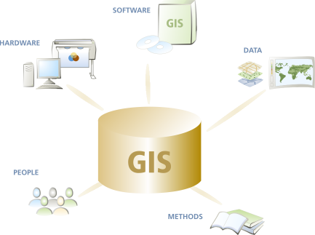
What are the components of GIS?
Hardware
computers, printers, servers
Software
programs, applications
Data
information, tables,
spreadsheets, databases
Methods
how to ask questions
People

Slide 10
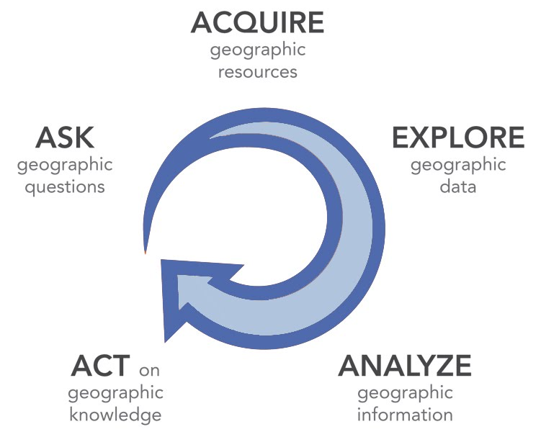
What are the processes of GIS?
Ask
What is the problem
Acquire
Find needed data
Examine
Evaluate & organize data
Analyze
Methods to create new output
Act
Share results with your audiences

Slide 11
Benefits of GIS in Education Why is it important?
Movie (9:12): YouTube Video

Slide 12
Benefits of GIS in Education
Analyze the key issues of the 21st Century
Inquiry and problem solving
Working with real data
Field work and community connections
Generating a geographic perspective
Critical thinking
Meaningful work with technology
Interdisciplinary work
Career pathways
Spatial thinking

Slide 13
Infrastructure Requirements
Computer hardware
Network connectivity
Educator knowledge & experience
Circulum materials available
Acquired an educational site-wide license
+30 license platforms with unlimited use
Desktop, server, tablet & smartphone platforms
Mobile (IOS, Windows Mobile & Android)
Business & community analyst applications
Cloud-based applications with ArcGIS Online

Slide 14
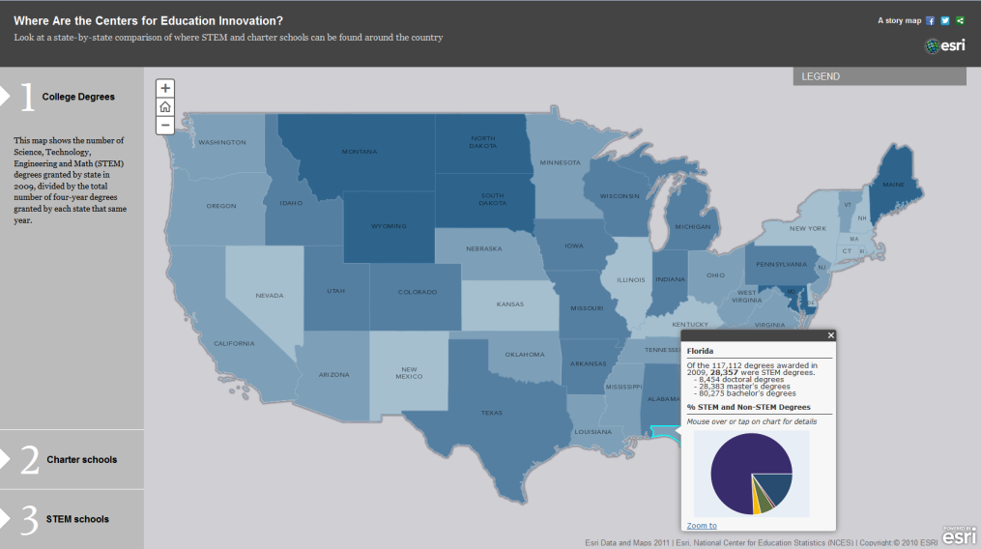
Freely Available Materials
Circulum & informational materials available
National Science Foundation (NSF)
U.S. Geological Survey (USGS)
National Geographic Society – Geo-Literacy Project
Institute for the Application of Geospatial Technology (IAGT)
GIS & Science Blog
ESRI or GIS.com
GIS2GPS Portal
Slideshare
District‘s site

Slide 15
Teaching Resources
Movie: Website

Slide 16
Question – Part 2: Why is it important? (to student learning & success)
Notes:
16

Slide 17
Geo-literacy in Education Why is it Important? (Preparing for Decision-Making in the 21 Century)
Movie (3:50): YouTube Video

Slide 18
Learning Important Skillsets
Critical thinking
Cross-disciplinary problem solving
Connects STEM‘s focus discipines
Real-world concepts
Pathway to best solutions
Problem-based learning (PBL)
Great motivational tool
Involves latest technology

Slide 19
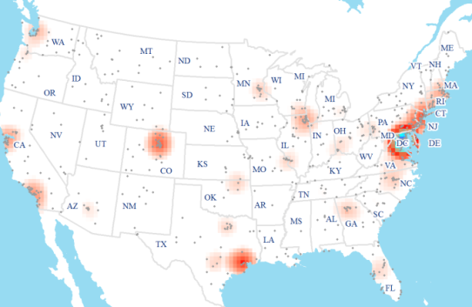
What is the GIS Job Market?
Industry grew by double digits in early 2010‘s
Is considered a “high growth industry“ (Dept. of Labor)
Expected annual growth of 35% each year through 2020
Florida was 4th of top 10 job postings states in GIS
Can earn an annual salary of up to $70,000
GIS Analyst (Information Technology Sector) rank in top 100 of Best Jobs in America (CNN Money)
Diversity of available jobs based on all educational levels

Slide 20
Types of jobs that use GIS
Computer Science
Electric/Gas Utilities
Business/Marketing
Telecommunications
Transportation Logistics
Petroleum & Mining
Engineering
Water & Wastewater
Health Care
Federal Government
Economics
Environmental Mgmt.
Local Government
School Districts
Geology
Military/Intelligence
Archeology
Sociology
Community Planning
Real Estate & Cadastral
Agriculture
Forestry
Public Safety
Risk Management
Aerial Photography

Slide 21
Presentation Takeaway
Activate
GIS In my
Classroom

Slide 22
Questions

Slide 23
Contact & Presentation Information
DavisW@lake.k12.fl.us / Ext. 6707
QR Code to Download PDF Version of Presentation

