Slide 1

Unlocking the Puzzle Box of Free On-line GIS
Will Davis, GISP & Harry Fix, AICP
Lake County Schools

Slide 2


Where’s Waldo?
Notes:
2

Slide 3
What is your level of GIS knowledge?
Have only heard of it in passing
Seen others use it before
Have a basic working knowledge
Have a good working knowledge
I consider myself an expert
Aa
Bb
Cc
Dd
Ee

Slide 4
Organizational Level’s use of GIS?
Not sure
Planning & Student Assignment
Transportation & Student Routing
Planning & Transportation Departments
Other Additional Departments
Aa
Bb
Cc
Dd
Ee

Slide 5
Importance of Public Transparency?
It only gets in the way of doing our job
We provide the Press what they ask for
We do Just enough to make a show
We hold public workshops & meetings
We involve all stakeholders in the process
Aa
Bb
Cc
Dd
Ee

Slide 6
What is this ArcGIS Online?
Cloud-based system
    Creating and sharing maps and geographic information
Upload and style geographic data
Create intelligent web maps
Author maps on any device
    Tables
    Smart Phones
    Desktops
Limited Service is “FREE”

Slide 7
What else can ArcGIS Online do?
Embed Maps
    Websites
    Blogs
    Applications
Share content
    Everyone
    Specific groups
    Keep completely private

Slide 8
What can ArcGIS Online do for you?
Provides for a
    Framework for collaboration
      Departmental
      Organization
      Stakeholders
      Public
    Platform to build applications
    Means to deliver transparency & accountability
    Way to communicate & enhance policy making

Slide 9
How ArcGIS Online Integrates the Parts
Students, Facilities or Addresses
Transportation Zones
Streets & Bus Routes
School Attendance or Student Analysis Zones
Tax Parcels, Facility or District Ownership
Aerial Photography
Reality

Slide 10
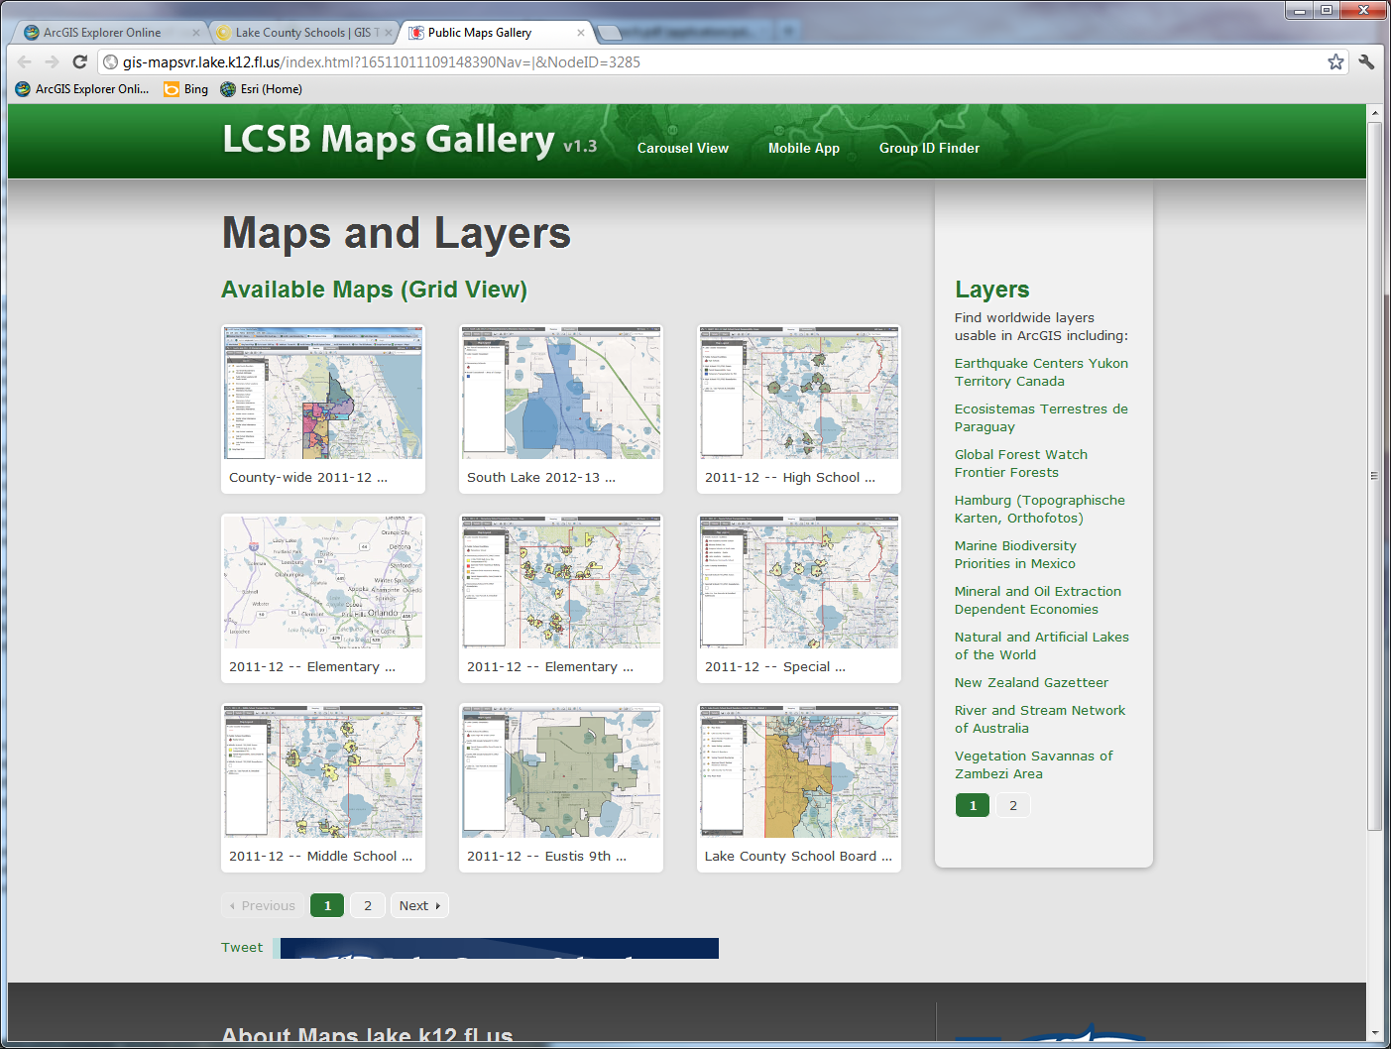
How Does the Lake District Use It

Slide 11
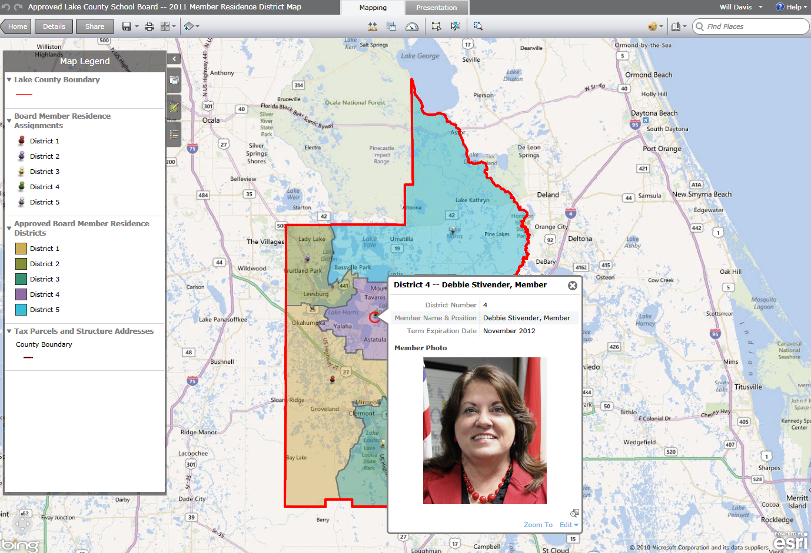
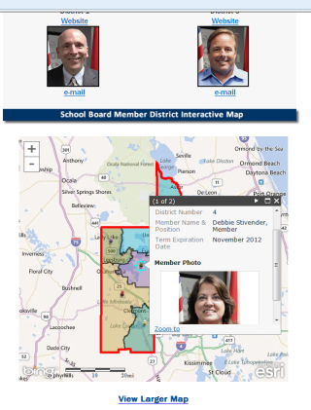
New Board Member District Maps
Web Embedded

Slide 12
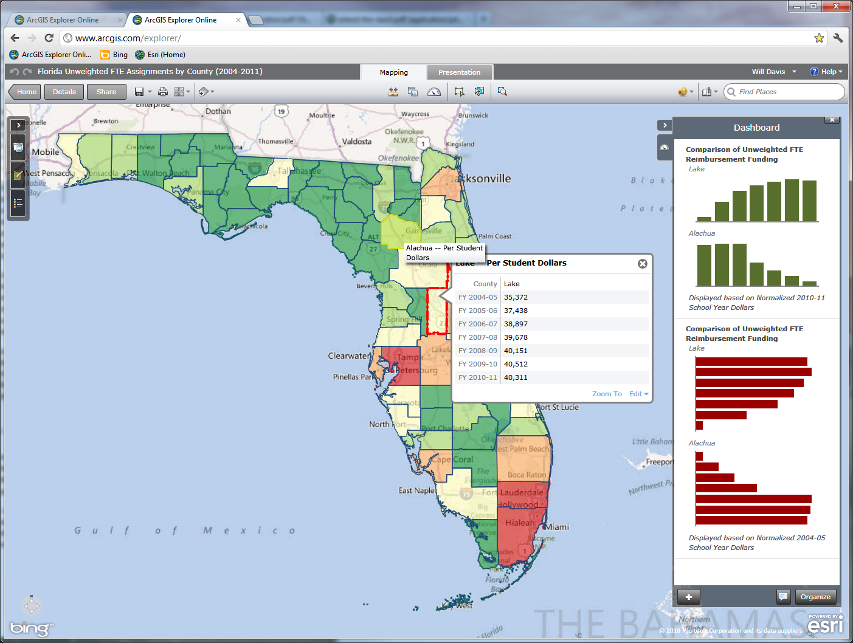
Florida Unweighted FTE Assignments

Slide 13
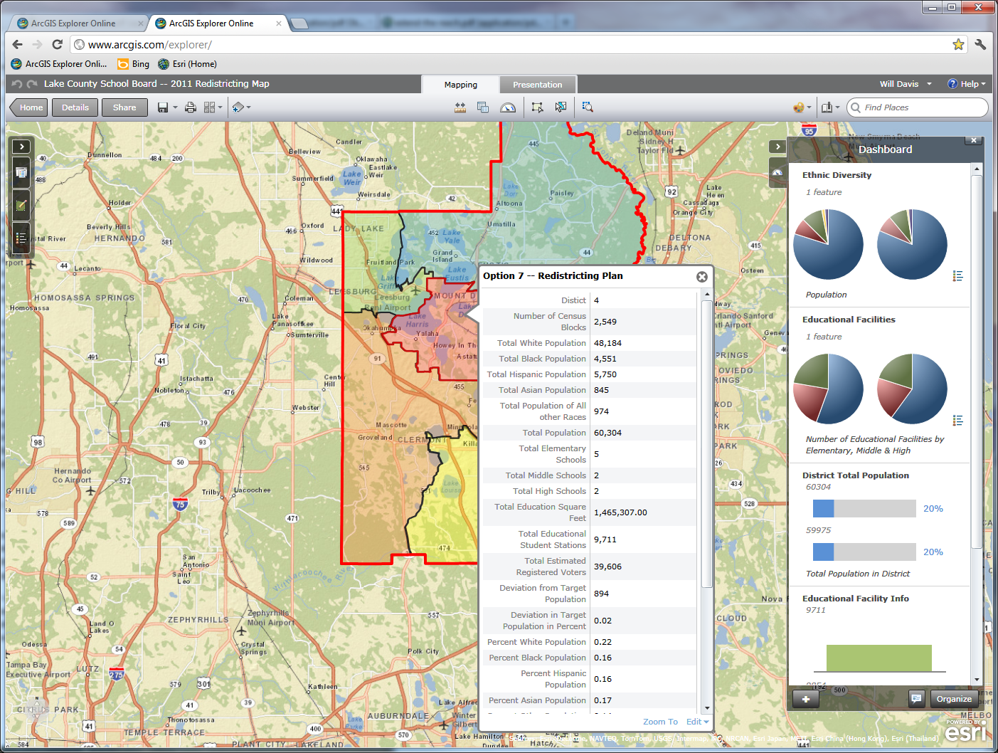
Board Member Redistricting Options

Slide 14
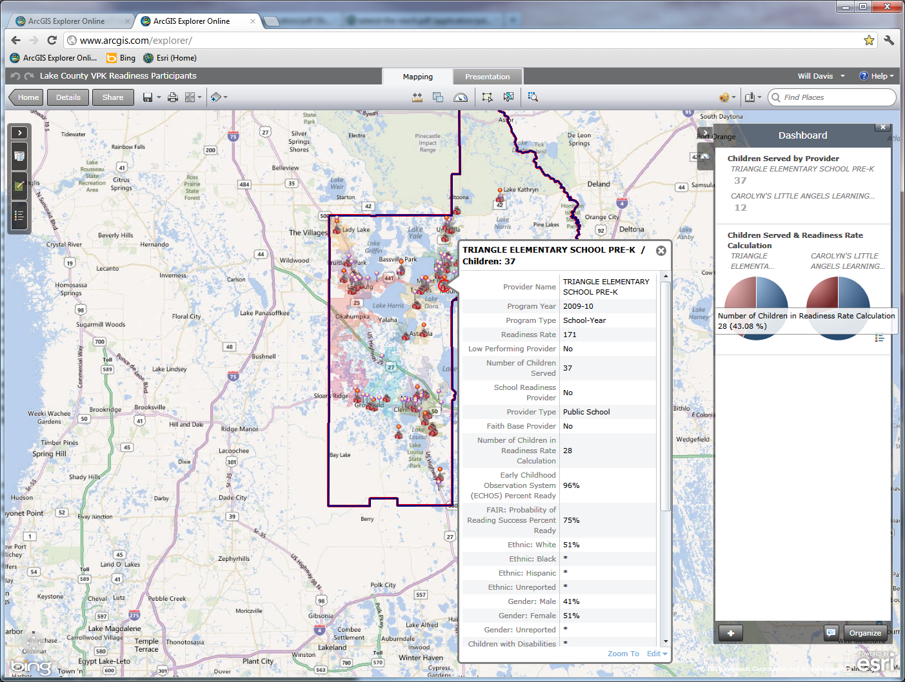
VPK Readiness Participants

Slide 15
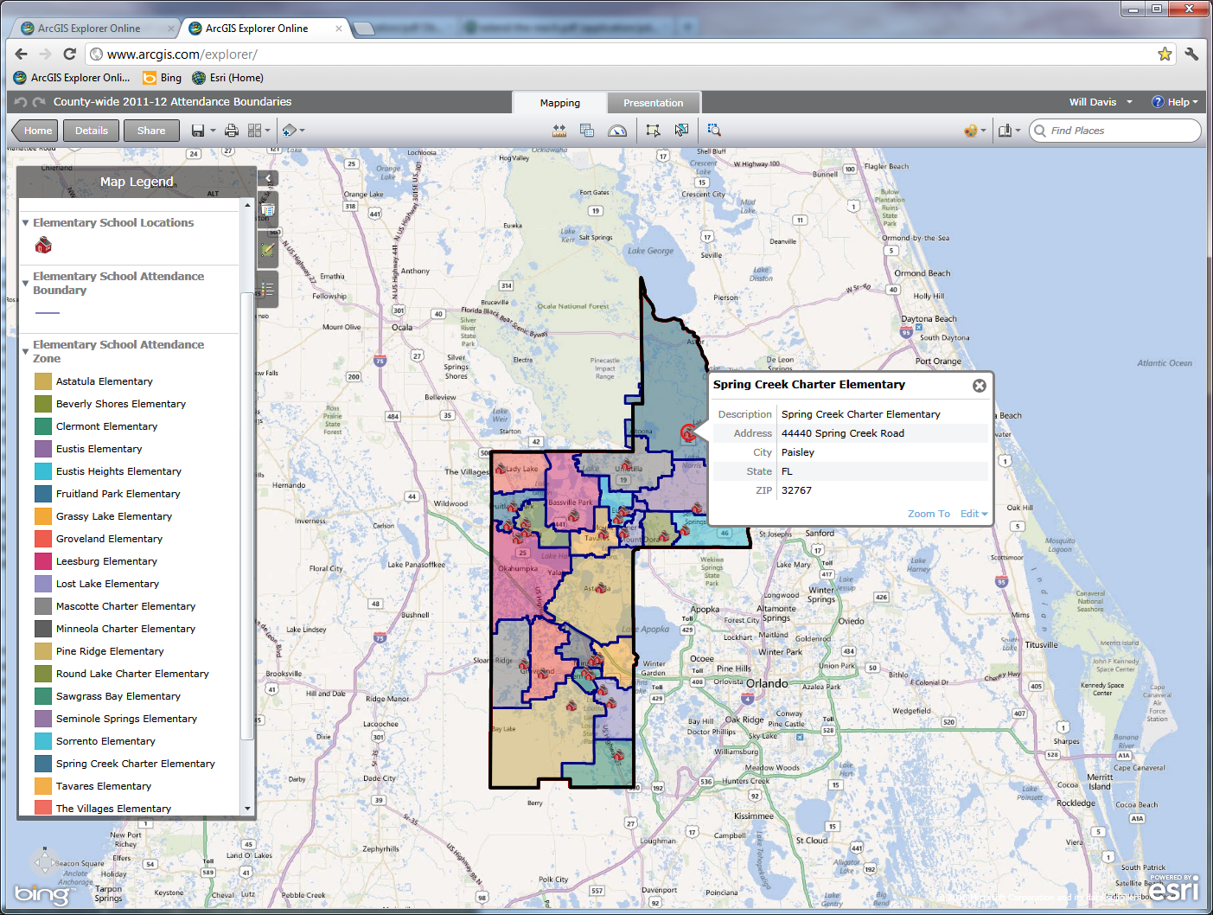
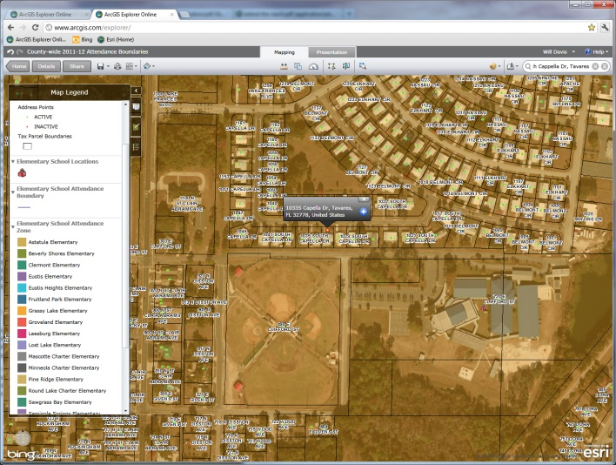
Attendance & Transportation Zones

Slide 16
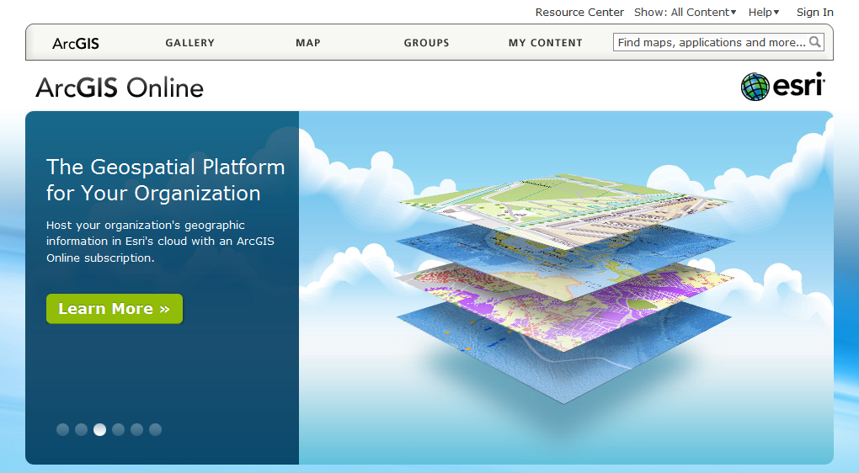
Type in http://www.arcgis.com on your browser
Gaining Access to ArcGIS Online

Slide 17
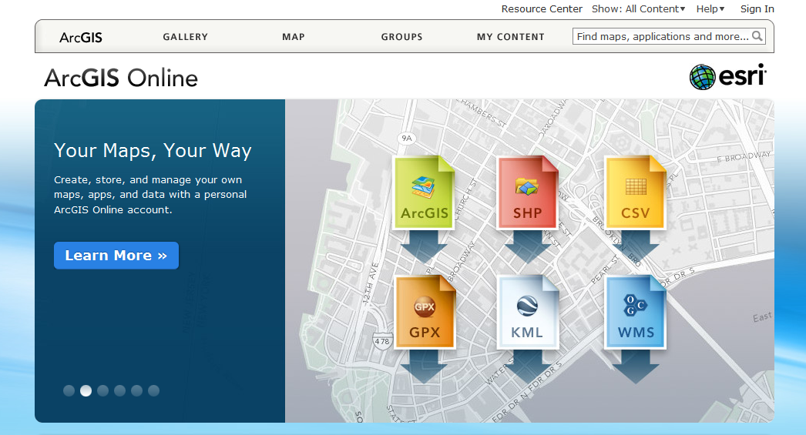
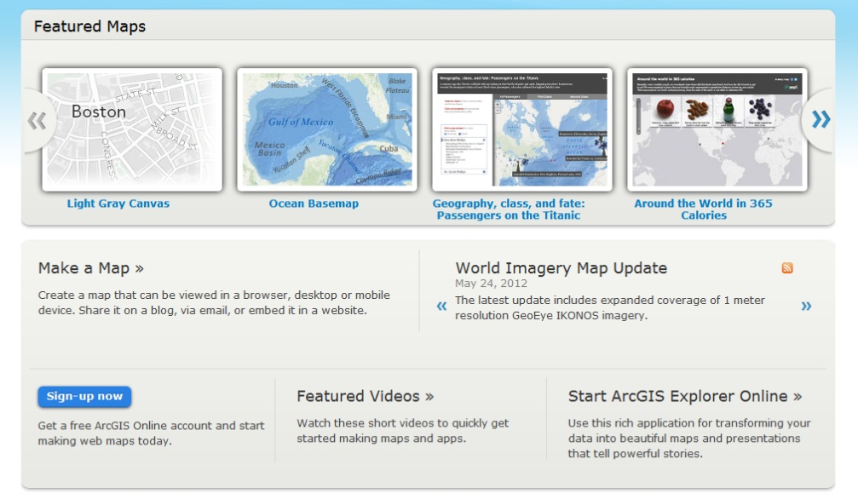
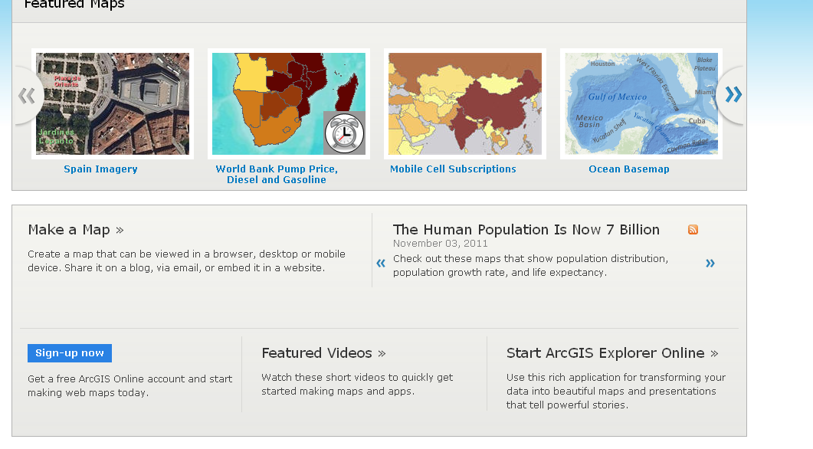
Sign-up for a ArcGIS Online Account

Slide 18
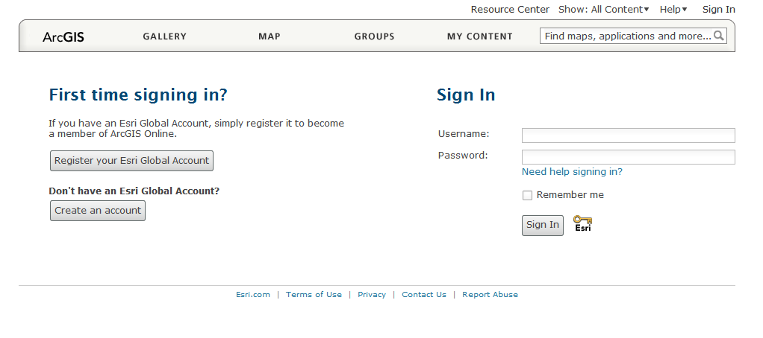
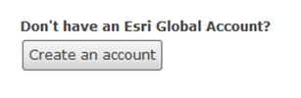
Create an ArcGIS Online Account

Slide 19
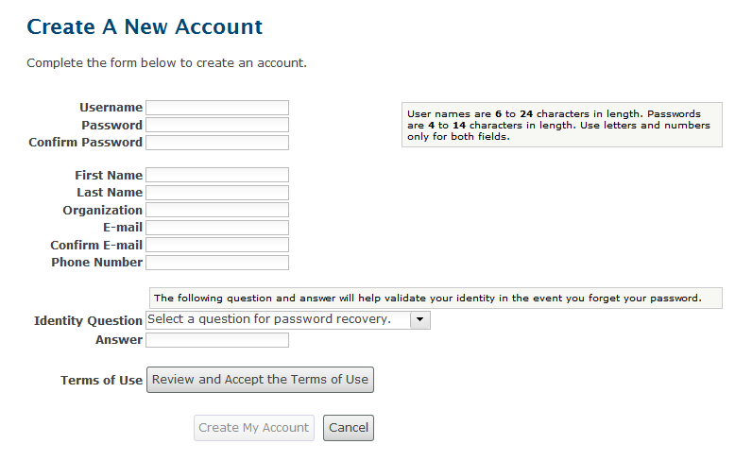
Complete form for an Account

Slide 20
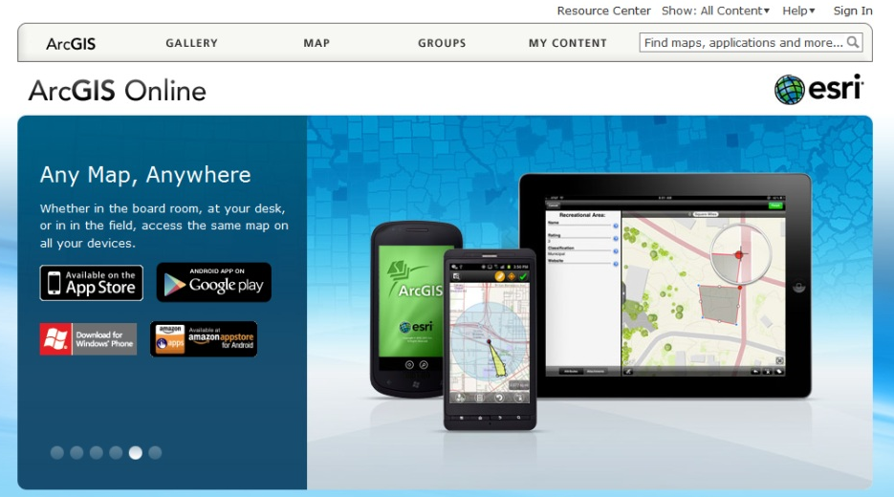
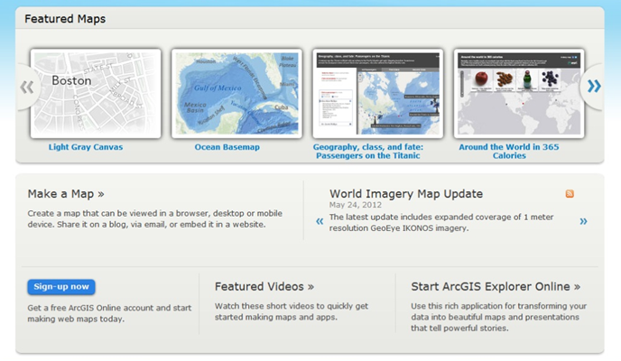
Browse back to http://www.arcgis.com
Gaining Access to ArcGIS Online

Slide 21
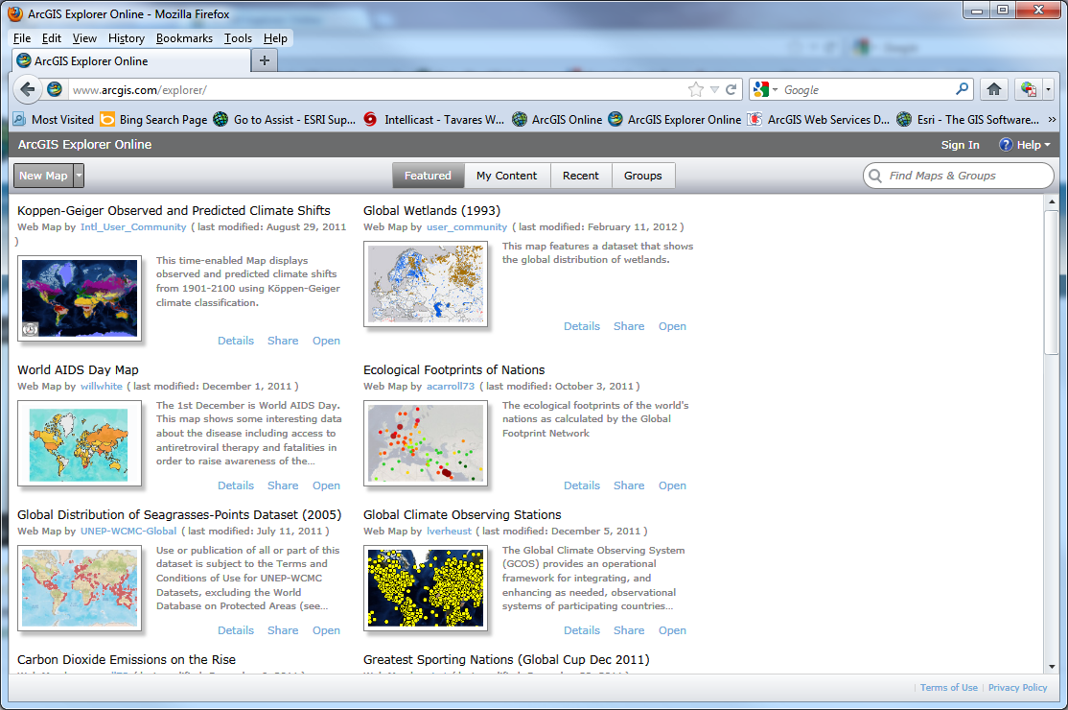
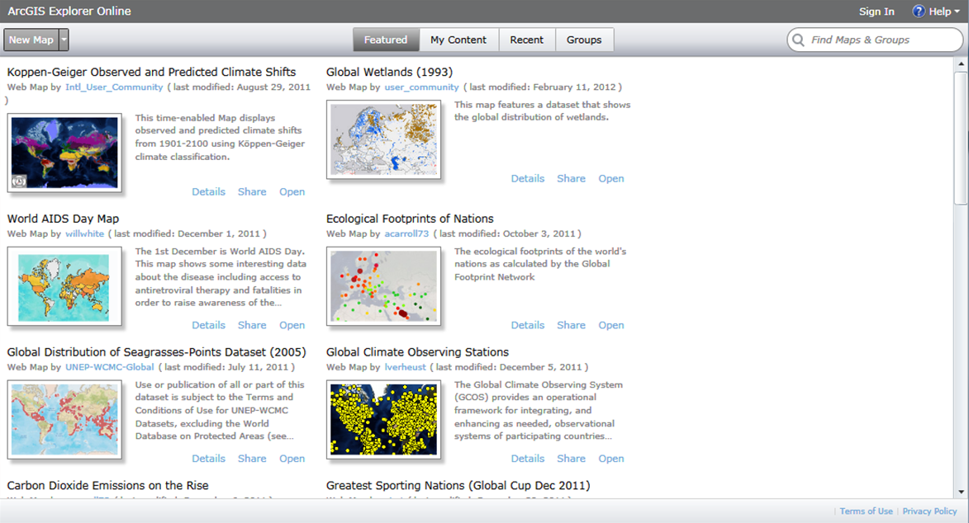
Sign-in to your new Account

Slide 22
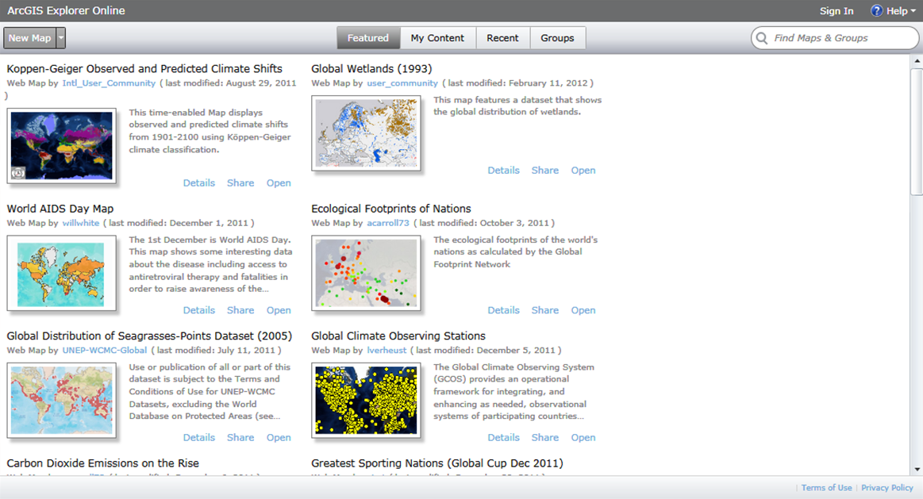
Creating a New Map

Slide 23
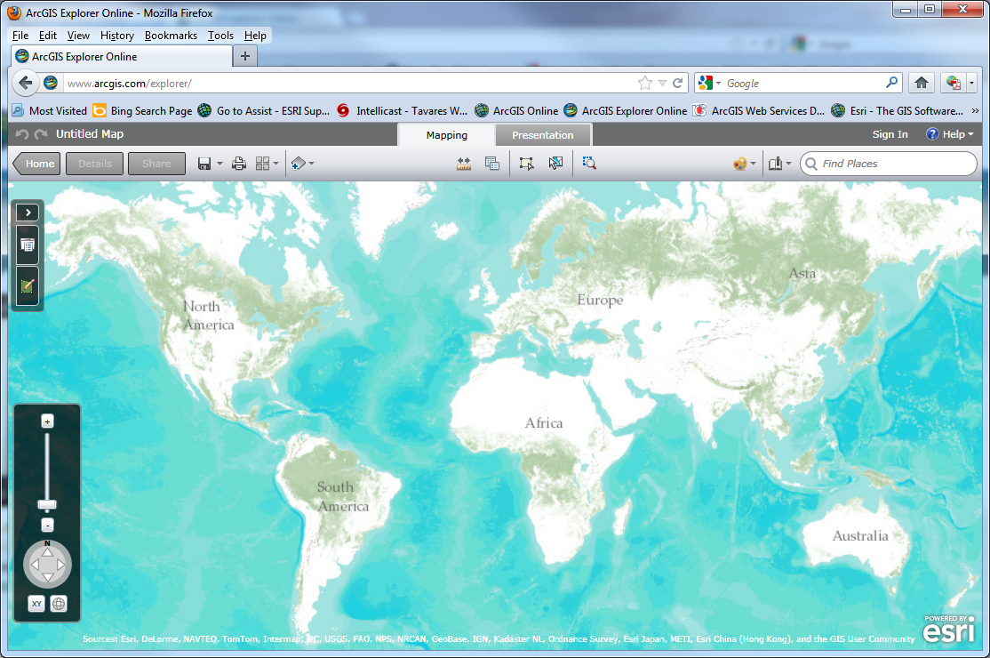
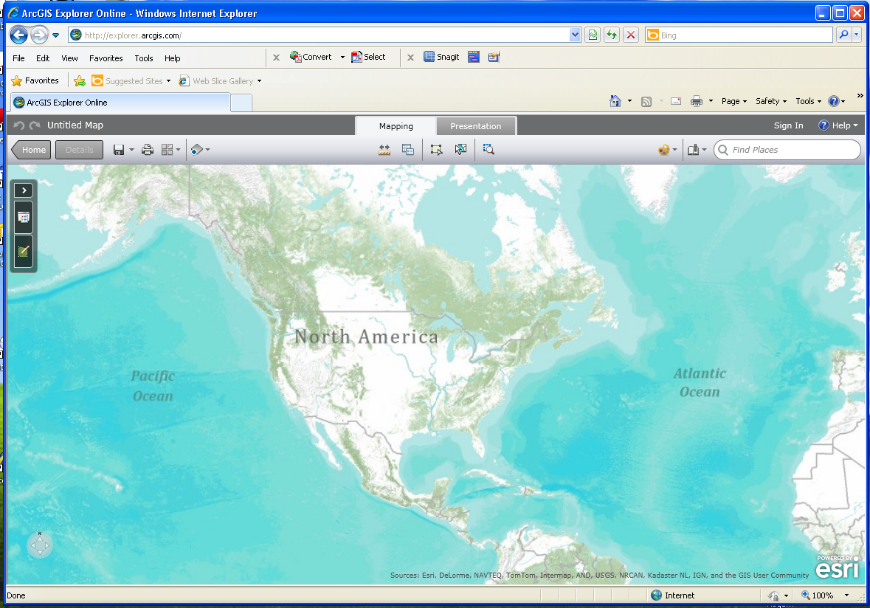
Basic Map Tools
Add Data, Change base-map, Save map
Search for Places, Add bookmarks

Slide 24
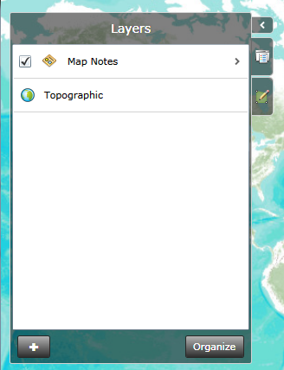
Basic Map Tools
Measure, Queries, Edit Feature, Select Features, Zoom to Rectangle
Layers, Add Features & Map Legend

Slide 25

Basic Map Tools
Scroll Wheel to Zoom
Help Button
Hold Left Button to Pan
Zoom & Map Movement Controls

Slide 26
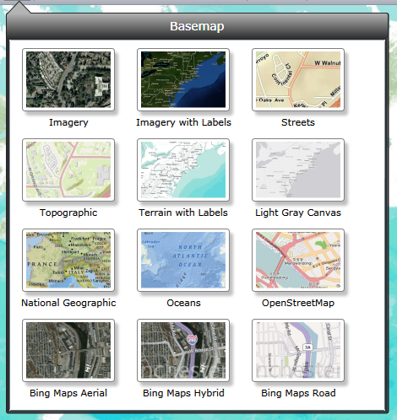
Changing the Base Map Background

Slide 27
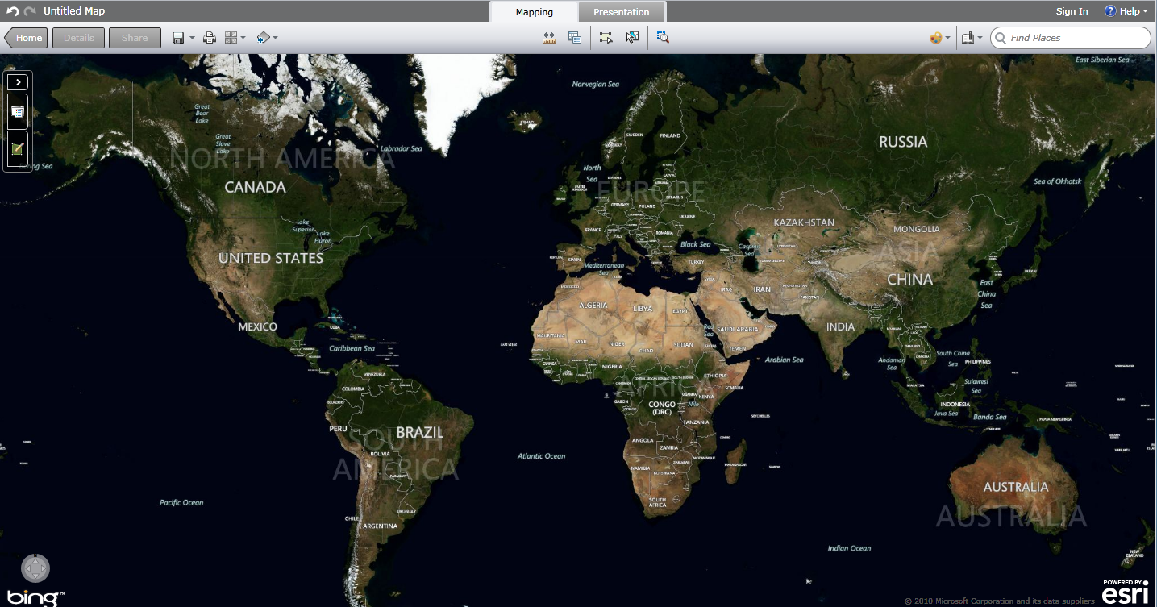
Search for an Address or Place
501 East Camino Real, Boca Raton, FL

Slide 28
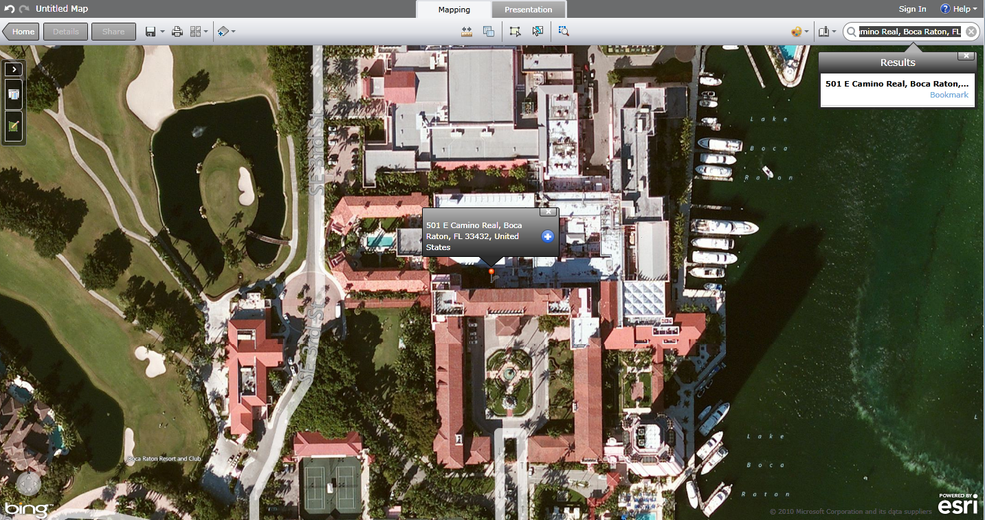
Search for an Address or Place

Slide 29
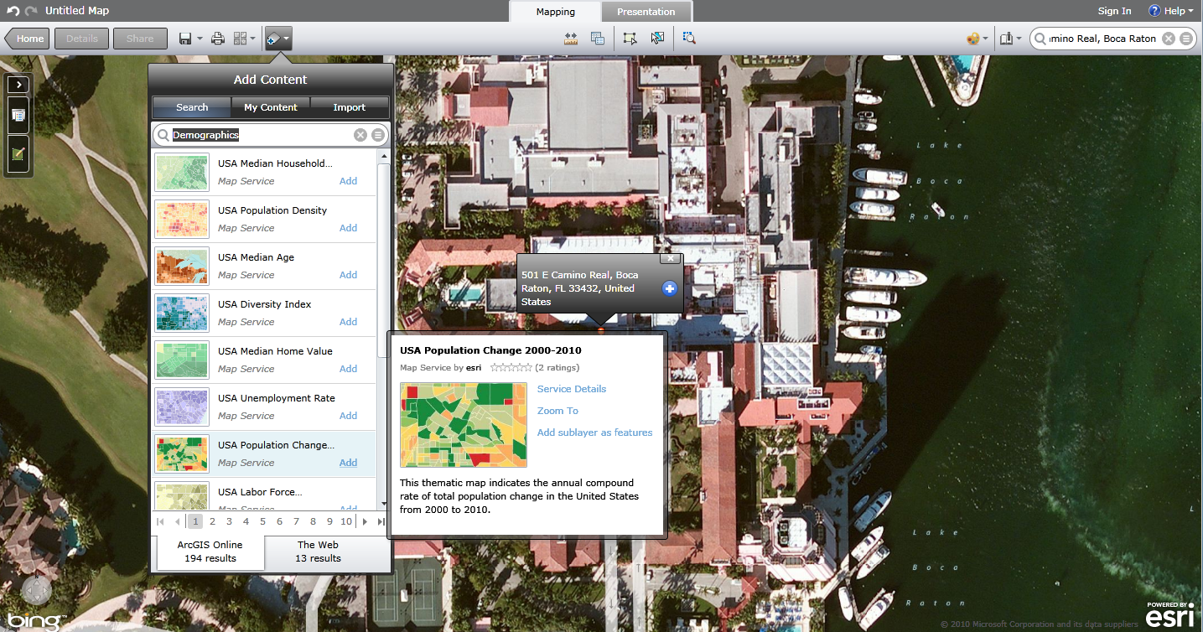
Search for Online Content
Search for: “Demographics”

Slide 30
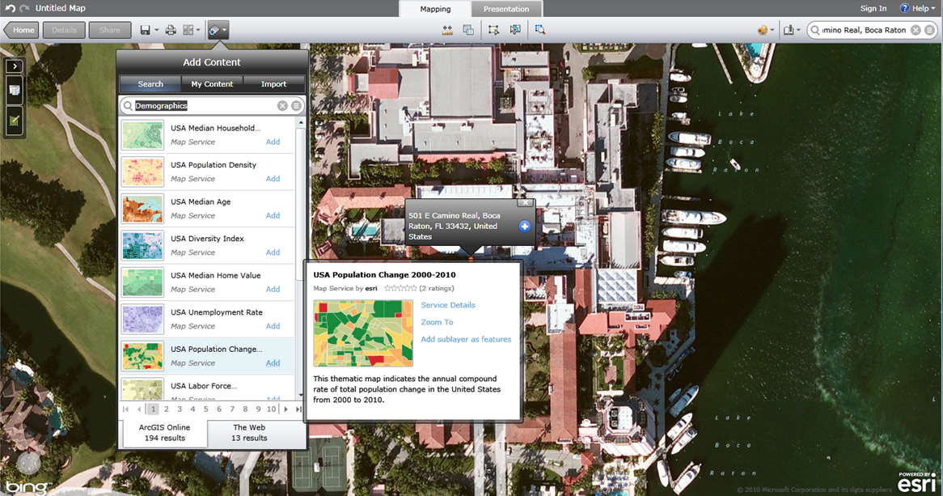
Working Exercise
Select “Add”
http://gis-mapsvr.lake.k12.fl.us/Maps/Presentations/FacilitiesFlatFile.csv
http://bit.ly/JyV0fE

Slide 31
Is ArcGIS Online for me?
It doesn’t seem to have any use for me
I like it but it’s beyond my level of expertise
I’ll be glad to share it with my GIS/IT staff
I see some utility in my own organization
I see a need and I’m ready to start using it
Aa
Bb
Cc
Dd
Ee

Slide 32

Presentation Takeaway

Slide 33

Questions

Slide 34
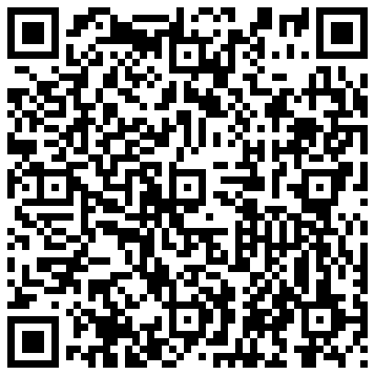
Contact & Presentation Information
Will Davis – DavisW@lake.k12.fl.us

