Slide 1
“Public participation is too often a formality of information delivery rather than an honest seeking of the public’s point of view. People get that fact quickly, and the result can be far worse than not involving them at all in a planning process. On the other hand, a responsible group of citizens can represent diverse expertise and points of view that thoroughly enrich a school district facilities planning process.” – Kelley Carey

Slide 2
Harry Fix & Kelly Randall
Lake County Schools
The Puzzling Piece of
Public Participation

Slide 3

The Big Puzzle Picture of Public Participation
What?
Why?
Where?
How?
When?
Who?

Slide 4


The Big Puzzle Picture of Public Participation
Who?
What?
Why?
When?
Where?
How?

Slide 5

First Puzzle Piece – What?
What is public participation?
  Involvement
  Information
  Communication
In decision making
Notes:
‘Public participation’ is to involve those who are affected by a decision in the decision-making process. It promotes sustainable decisions by providing participants with the information they need to be involved in a meaningful way, and it communicates to participants how their input affects the decision. - iap2

Slide 6
Second Puzzle Piece – Why?
Support (consensus)
Accountability
Credibility
Knowledge

Slide 7
Third Puzzle Piece – Who?
Parents
Advocacy Groups
District Staff
Development Community
Local Government
Everyone else
      Taxpayers
      Other educational agencies

Slide 8
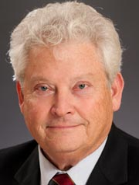
“A plan already cast in concrete before public discussion makes a mockery out of public involvement.”
– Kelley Carey

Slide 9

Fourth Puzzle Piece – When?
Good Data
Early on
Through out
  Public hearings are too late!

Slide 10
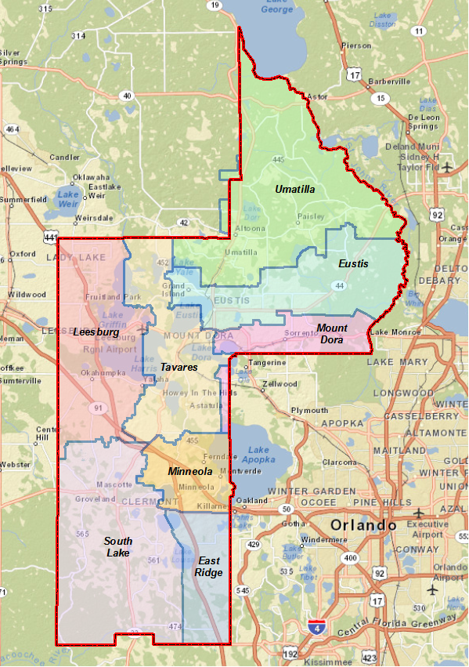
Fifth Puzzle Piece – Where?
Lake County Schools
A Case Study
Facilities Assessments
Local Area Focus
Advisory Committees

Slide 11
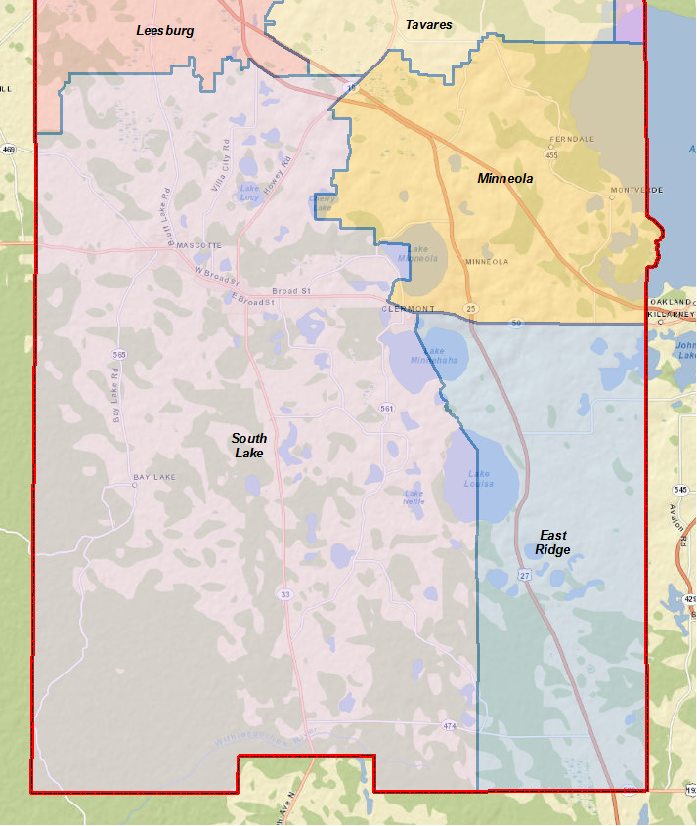
Fifth Puzzle Piece – How?
South County Long-range Planning Committee
Facilities Considered
Clermont Elem
Cypress Ridge Elem
Clermont Middle

Slide 12
Fifth Puzzle Piece – How?
Background Information
Good data:
  School Specific
  Demographics
  Financial
Tours
Concept Plans

Slide 13
Fifth Puzzle Piece – How?
SAC/PTO Review
Committee Feedback
Concept Plan Revision
Final Report
School Board Acceptance

Slide 14
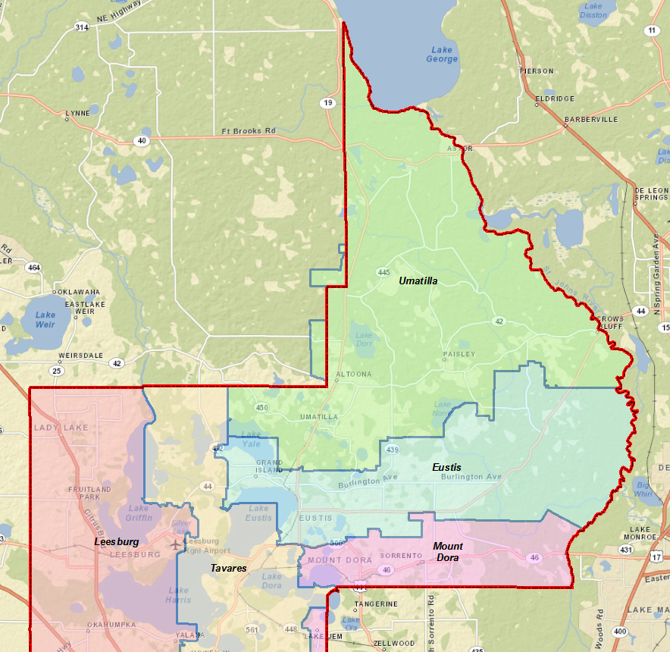
Fifth Puzzle Piece – How?
Northeast Long-range Planning Committee
Facilities Considered
Curtright Center
Eustis Elem
Eustis Heights Elem
Umatilla Middle

Slide 15
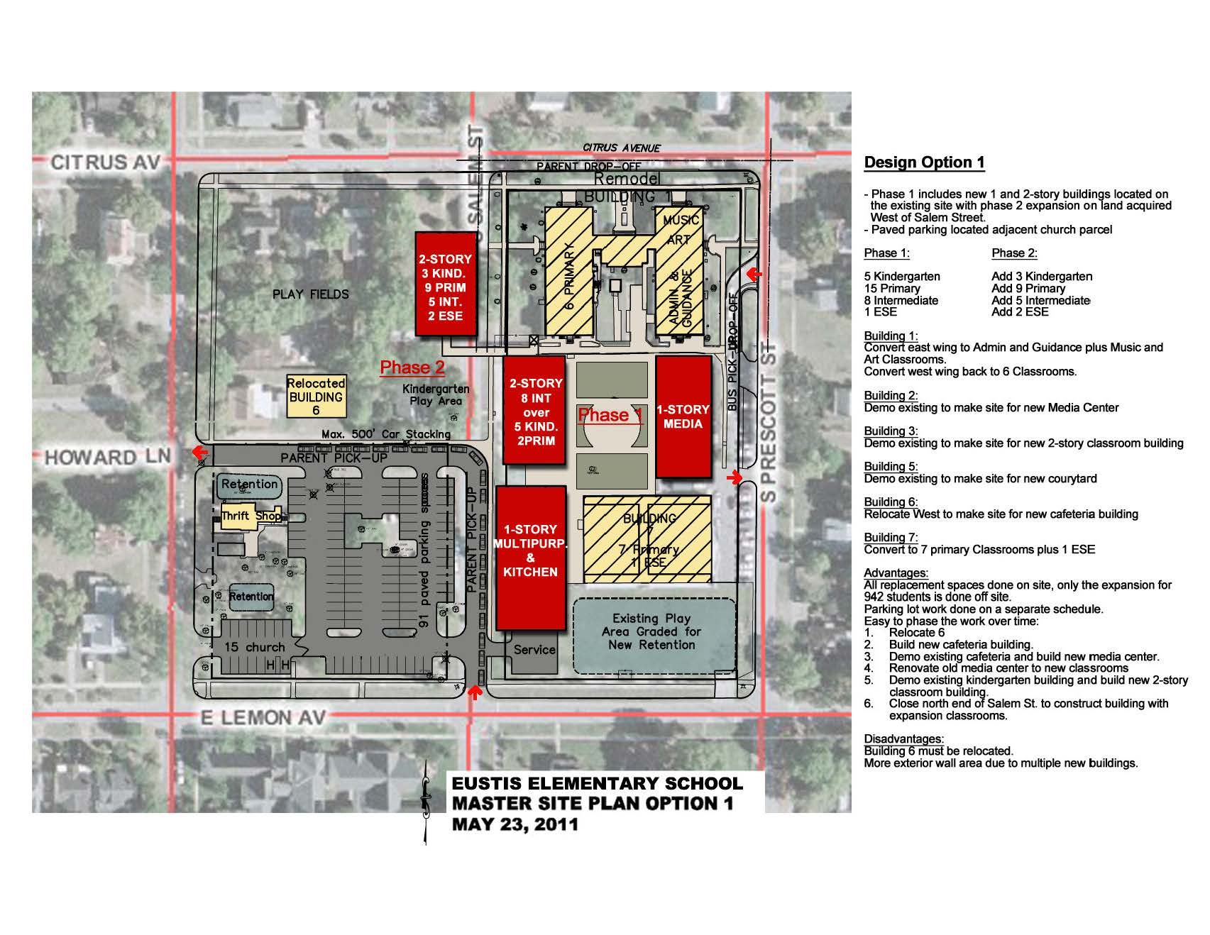
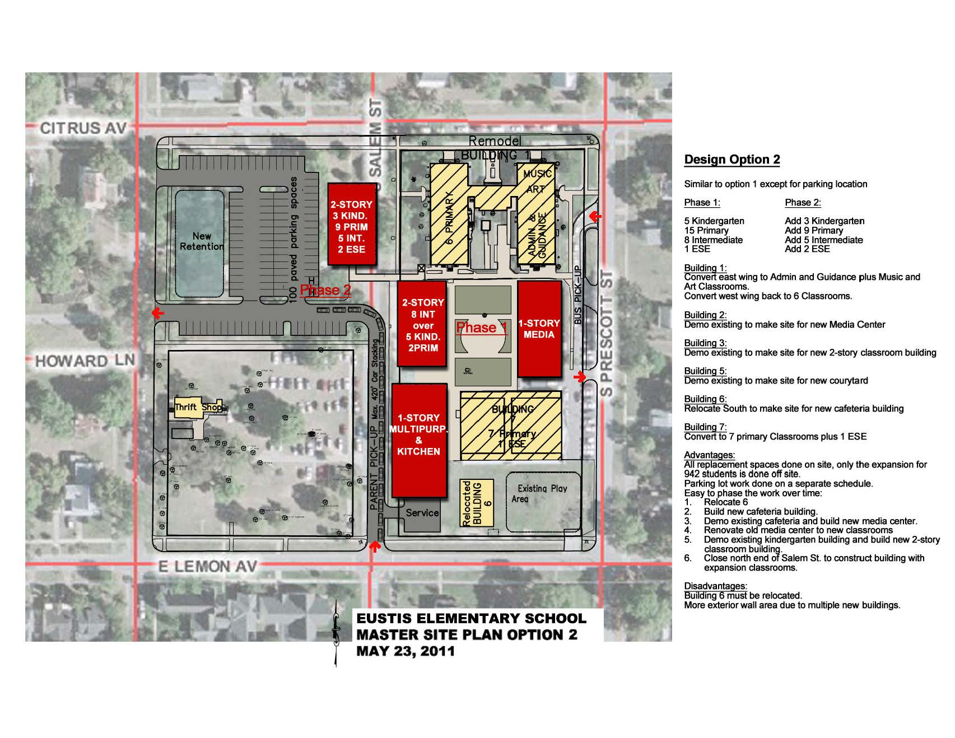
Fifth Puzzle Piece – How?

Slide 16
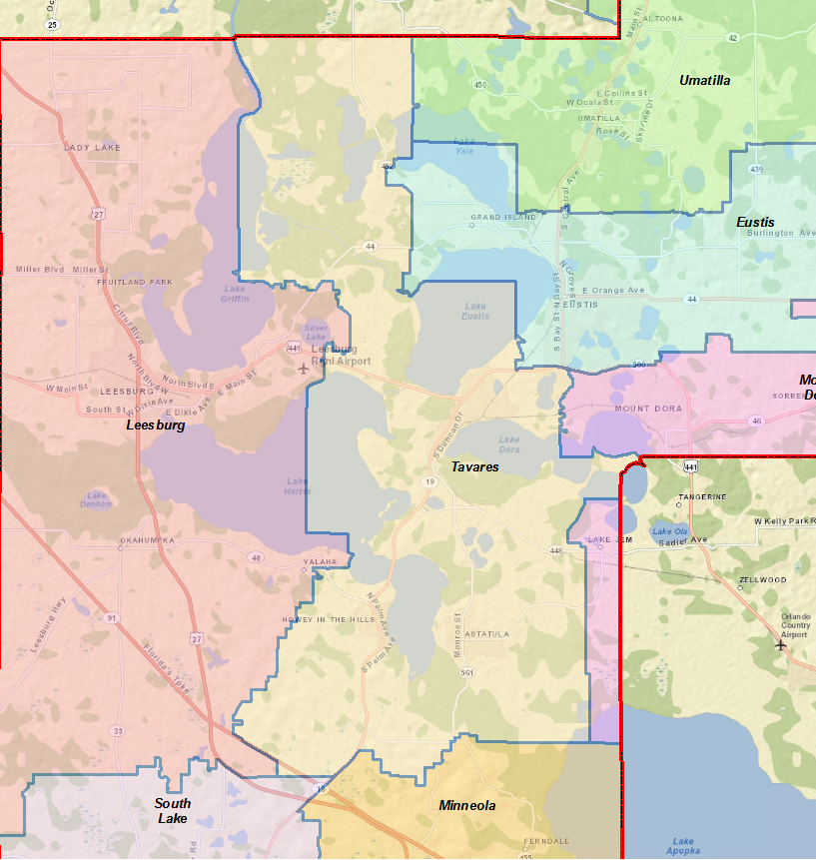
Fifth Puzzle Piece – How?
Northwest Long-range Planning Committee
Facilities Considered
Beverly Shores Elem
Fruitland Park Elem
Oak Park Middle
Rimes ELC
Treadway Elem

Slide 17
Fifth Puzzle Piece – How?

Slide 18
Putting the Puzzle Together
(Where do we go from here?)
Next steps . . .
Recommendations adopted
Long-range CIP updated
Extraordinary funding sources sought
  County-wide funding committee
  Potential referendum

Slide 19
Puzzled?
(question?)

