Slide 1
Gaining Student Excitement in GIS with ArcGIS Explorer Online
The Lake County Experiment

Slide 2
Background
Where Do You Sit
Questionnaire
Who has participated in GIS Day?
Why did you participate?
Did your participation involve Students?
How do you rate your interest in GIS?
It’s an interesting career
I enjoy what I do
I’m passionate about what I do

Slide 3
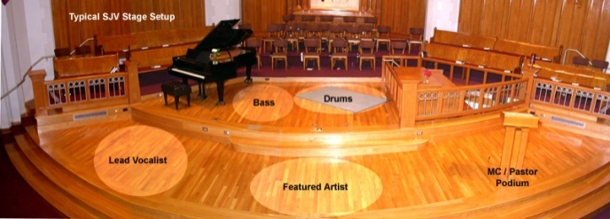
Background
Setting the Stage
Past experiences
Capture their interest
What’s missing
Where do you start
Collaboration is key
Icing on the cake
Handing out the prize
What we learned
For the future
Great compliments

Slide 4
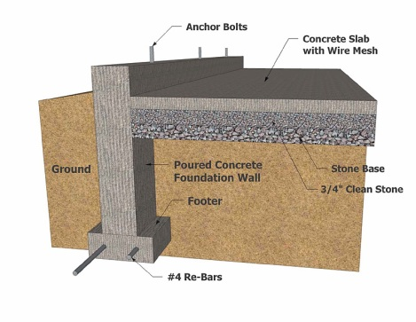
Background
Past Experiences
Freshman Foundations
9th grade students
Focused on career choices
The mechanics on how to land a job
Utilizes business professionals from the community to tell their story

Slide 5
Background
Past Experiences
Presentation Focus
Who uses GIS (professions/businesses)
What is GIS (parts & integration)
When & How it is used (Geospatial Revolution Project)
Where it is used (desktops, servers & smart phones)

Slide 6
Background
Capture Their Interest
Attention span
Attention Deficit Disorder (ADD)
Sleep deprivation
Generate interest
Force interaction
Solicit questions
Ask for feedback (teacher)

Slide 7
Background
What’s Missing
Student engagement
Hands-on interaction
Dynamic map application
ArcGIS Explorer Online

Slide 8
Background
Where Do You Start
Create a working group
Determine your team size
Understand your capabilities
Technical & presentation skills
Establish your connections
Top down or bottom up

Slide 9
Where Do You Start
Identify site resources
Define your target audience
Generate a presentation outline
Assign tasks to group members
Practice a run-through of the presentation (more is better)
Don’t be afraid to change on the fly

Slide 10
Collaboration is Key
Establish a dialogue with Teachers
Ask about curriculum needs
Discuss what & where will they be studying at the time of your presentation
Insist on the use of a computer lab
Demo ArcGIS Explorer Online
Help them set up an online global account
Provide assistance on establishing groups
Assure access to the Silverlight plugin

Slide 11
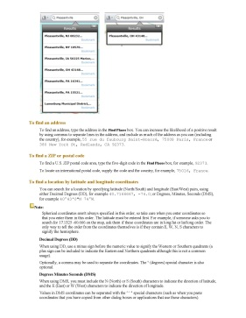
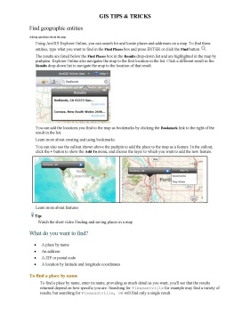
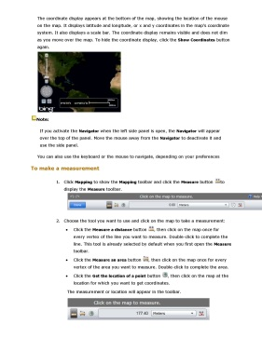
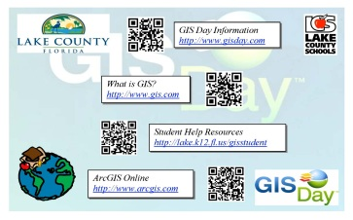
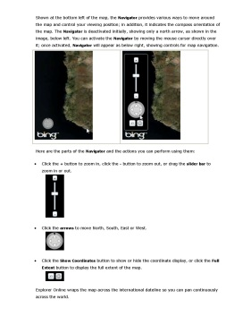
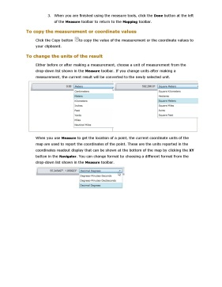
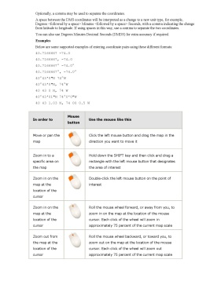
Icing on the Cake
Create your materials
Handouts, tips sheets, web page & exercises

Slide 12
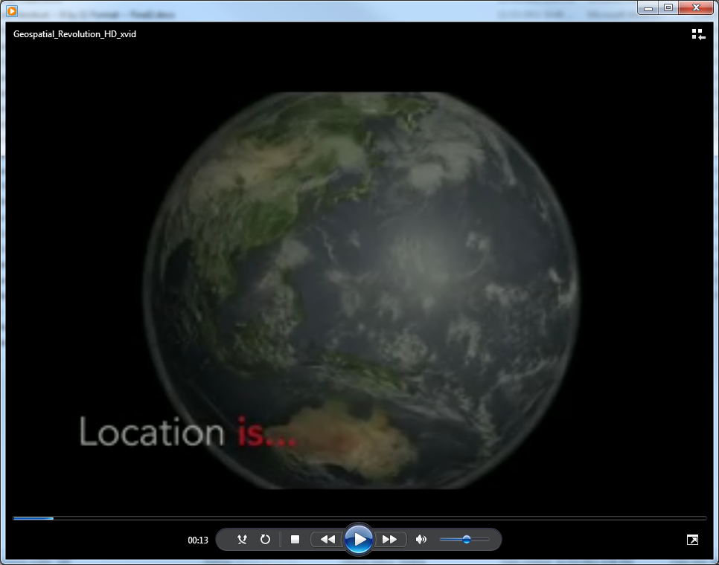
Icing on the Cake
Acquire your resources
Videos, prizes & certificates
Geospatial Revolution Project

Slide 13
Icing on the Cake
Build your presentation

Slide 14
Handing out the Prizes
Provide your message

Slide 15
What We Learned
Provide quick overview of GIS
Work on setting up accounts
Highlight functionally of ArcGIS Explorer Online
Perform a formal class exercise
Spend time searching local layers
Provide time to experiment
Get out of the way

Slide 16
What We Learned
One day or two day class model
High school vs. middle school
Set the stage and turn them loose
Keep spatial reference local
Allow 10 minutes for free style
Provide access to web resources

Slide 17
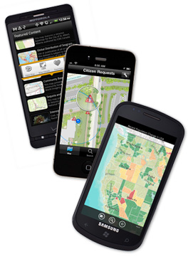
For the Future
Utilize Mobile Technologies

Slide 18
Great Compliments
“I’ve rarely seen 100% engagement in any lesson activity as I have with ArcGIS Explorer Online. It was a great success!”
Diane Reid-Goolsby, Teacher
6th Grade Geography

Slide 19
Web Resources
GIS Day => http://gisday.com/
Teachers => http://bit.ly/Jr28sU
Students => http://bit.ly/IgJndD
Materials => http://bit.ly/Jw4c0b
Mark the Day: November 14, 2012

Slide 20
Take Away

Slide 21
Contact Information
Will Davis – DavisW@lake.k12.fl.us

Slide 22
Contact Information
Will Davis – DavisW@lake.k12.fl.us
GIS Day => http://gisday.com/
Teachers => http://bit.ly/Jr28sU
Students => http://bit.ly/IgJndD
Materials => http://bit.ly/Jw4c0b
Mark the Day: November 14, 2012

