Slide 1




GIS Day
Geography Matters™!

Slide 2
Introductions
Richard Helfst
Lake Co. Board of County Commissioners
Ben Garcia
Lake County Water Authority
Will Davis
Lake County Schools
Notes:
Geography is used to map anthropology finds and analyze migration patterns. It is also used to project growth in the future. Projections help determine where and when services like utilities and new schools will be needed.

Slide 3

Where’s
Waldo?
Notes:
3

Slide 4
Why is Location Important?

Slide 5

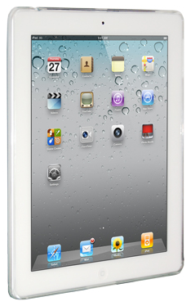
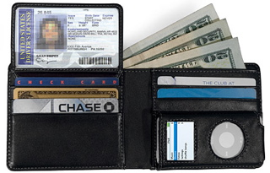



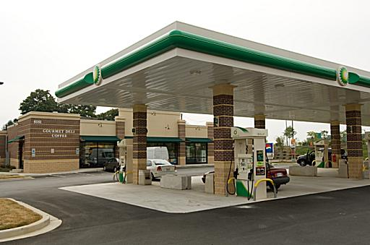

The Importance of Location!

Slide 6




The Life and Death of Location!

Slide 7
What Is Geography?

Slide 8
Geography
Geography is a science that enables us to find answers to questions about the world around us.
Geography helps us to locate where things are and how or why they are there.

Slide 9
What Is GIS?

Slide 10
Geographic Information Systems
GIS is an abbreviation for geographic information systems which is a set of tools that captures, stores, analyzes, manages, and presents data that are linked to locations. In the simplest terms, GIS is the merging of cartography, statistical analysis, and database technologies to develop better solutions and make better decisions.

Slide 11
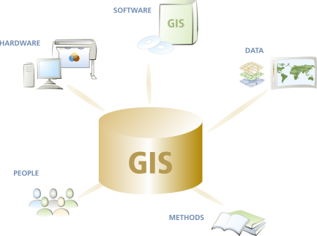
What Are the Parts of a GIS?
Hardware
computers, printers, servers
Software
programs, applications
Data
information, tables,
spreadsheets, databases
Methods
how to ask questions
People

Slide 12
GIS Integrates All the Parts… to See the Whole Picture!
Students
Future Development
Streets & Transportation
School Attendance Zones
Cities, Zoning & Land Use
Aerial Photography
Reality

Slide 13
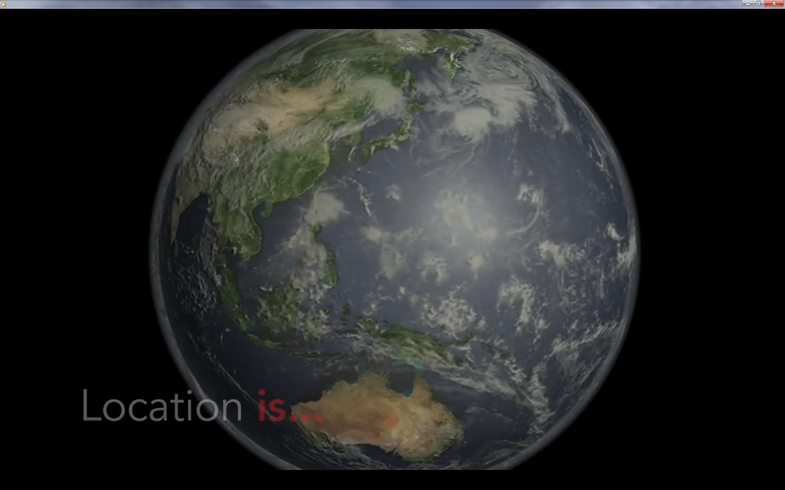
Geospatial Technology from Penn State University
(Geospatial Revolution Project)

Slide 14
What Types of Jobs Use GIS?

Slide 15
Jobs Where People Use GIS
Computer Science
Electric/Gas Utilities
Business/Marketing
Telecommunications
Transportation Logistics
Petroleum & Mining
Engineering
Water & Wastewater
Health Care
Federal Government
Economics
Environmental Mgmt.
Local Government
School Districts
Geology
Military/Intelligence
Archeology
Sociology
Community Planning
Real Estate & Cadastral
Site Location
Agriculture
Forestry
Public Safety
Risk Management
Aerial Photography

Slide 16

High-Tech Agriculture

Slide 17
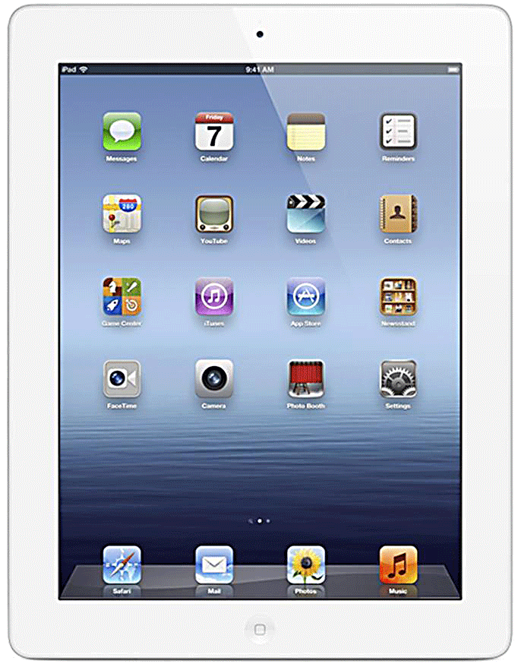
Demonstration of
ArcGIS.com using an iPad

Slide 18
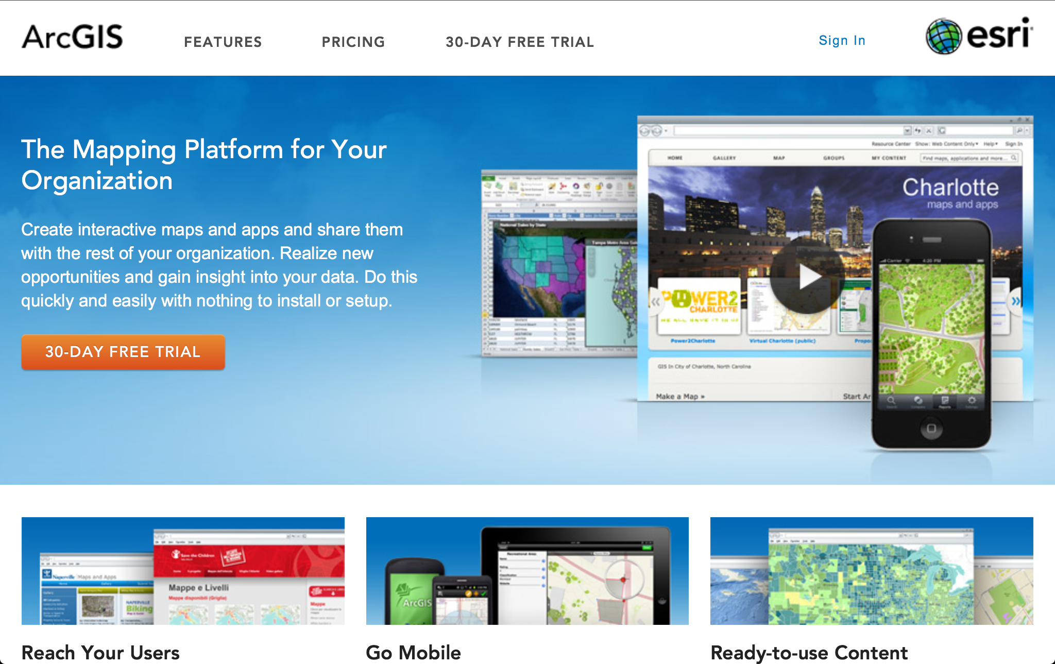
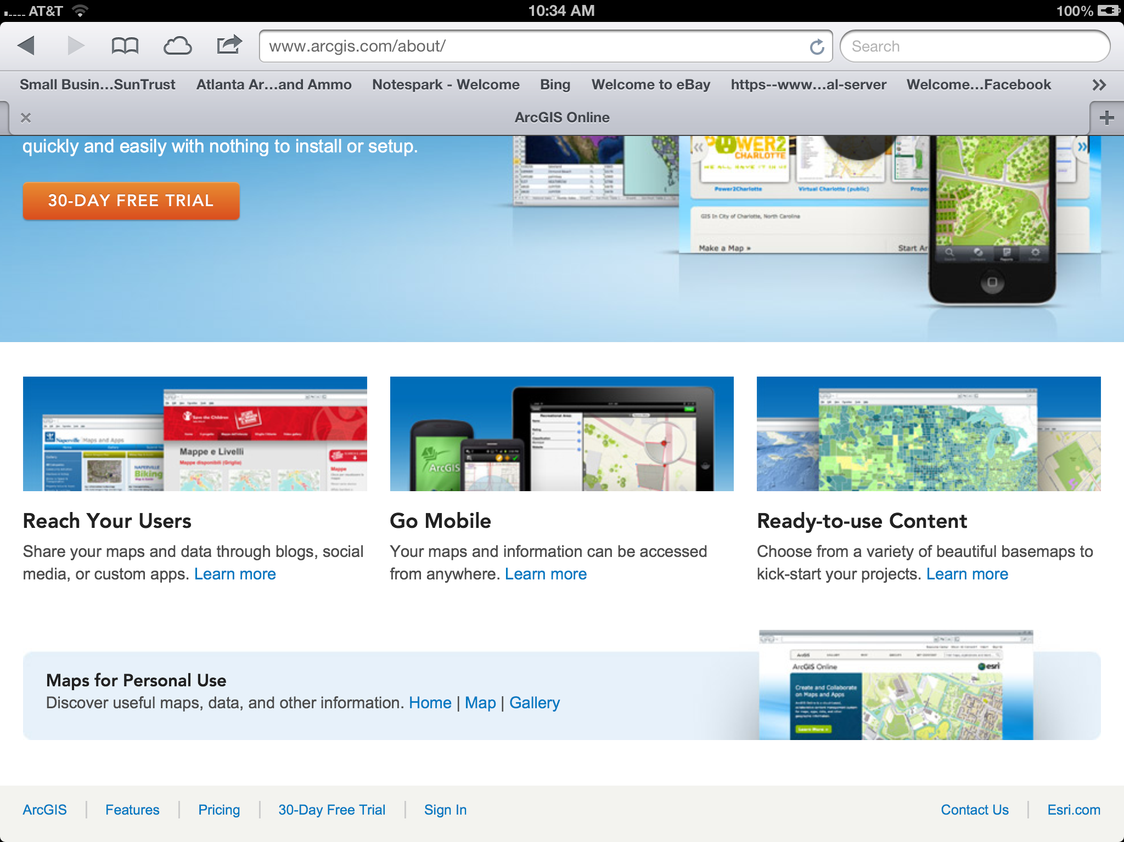
Type in www.arcgis.com on your Safari browser; click Maps at the bottom center of the page

Slide 19
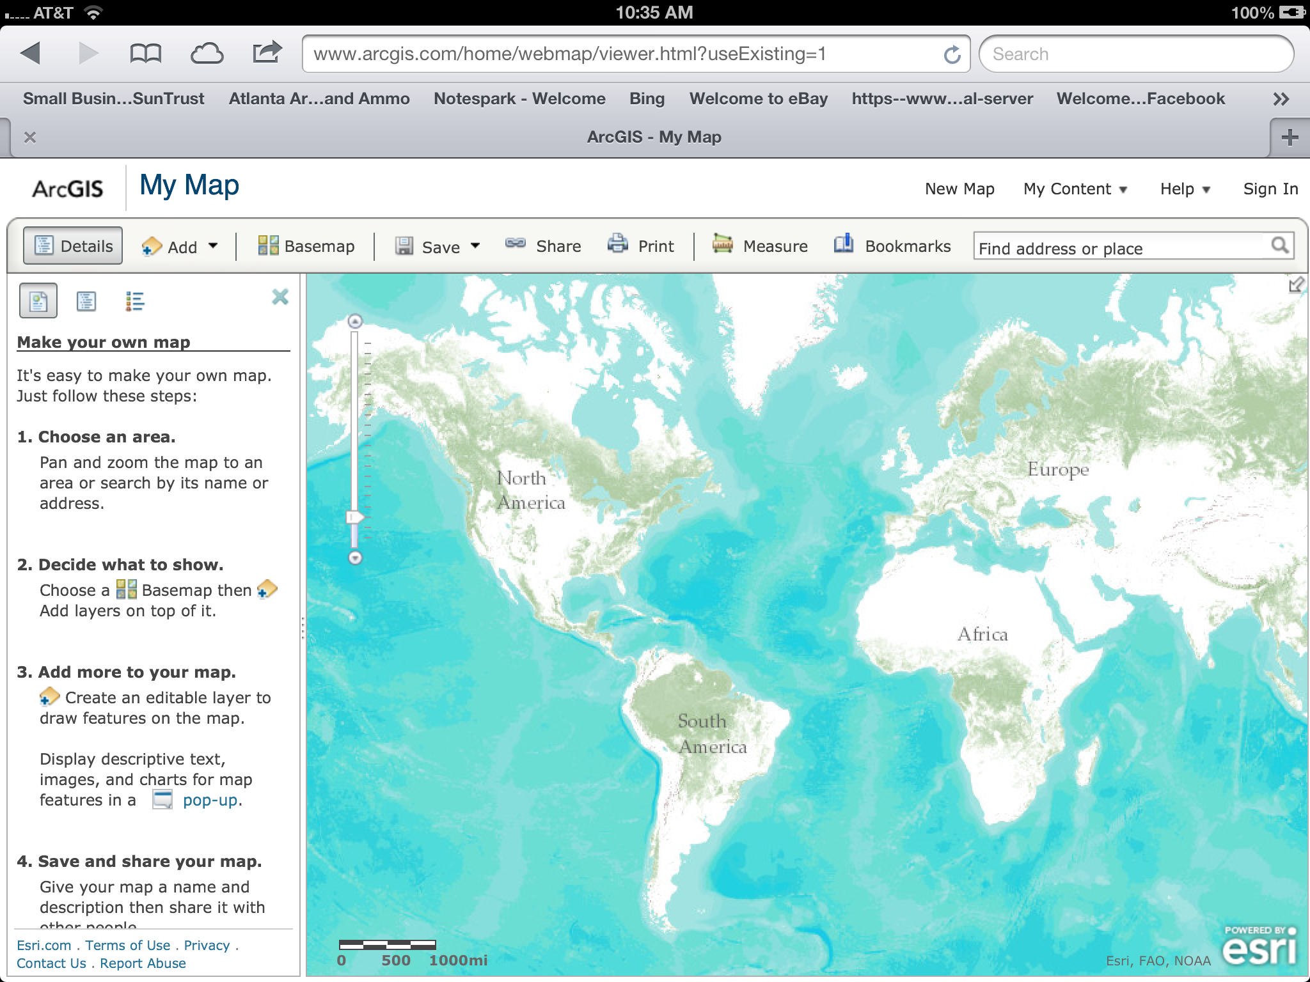
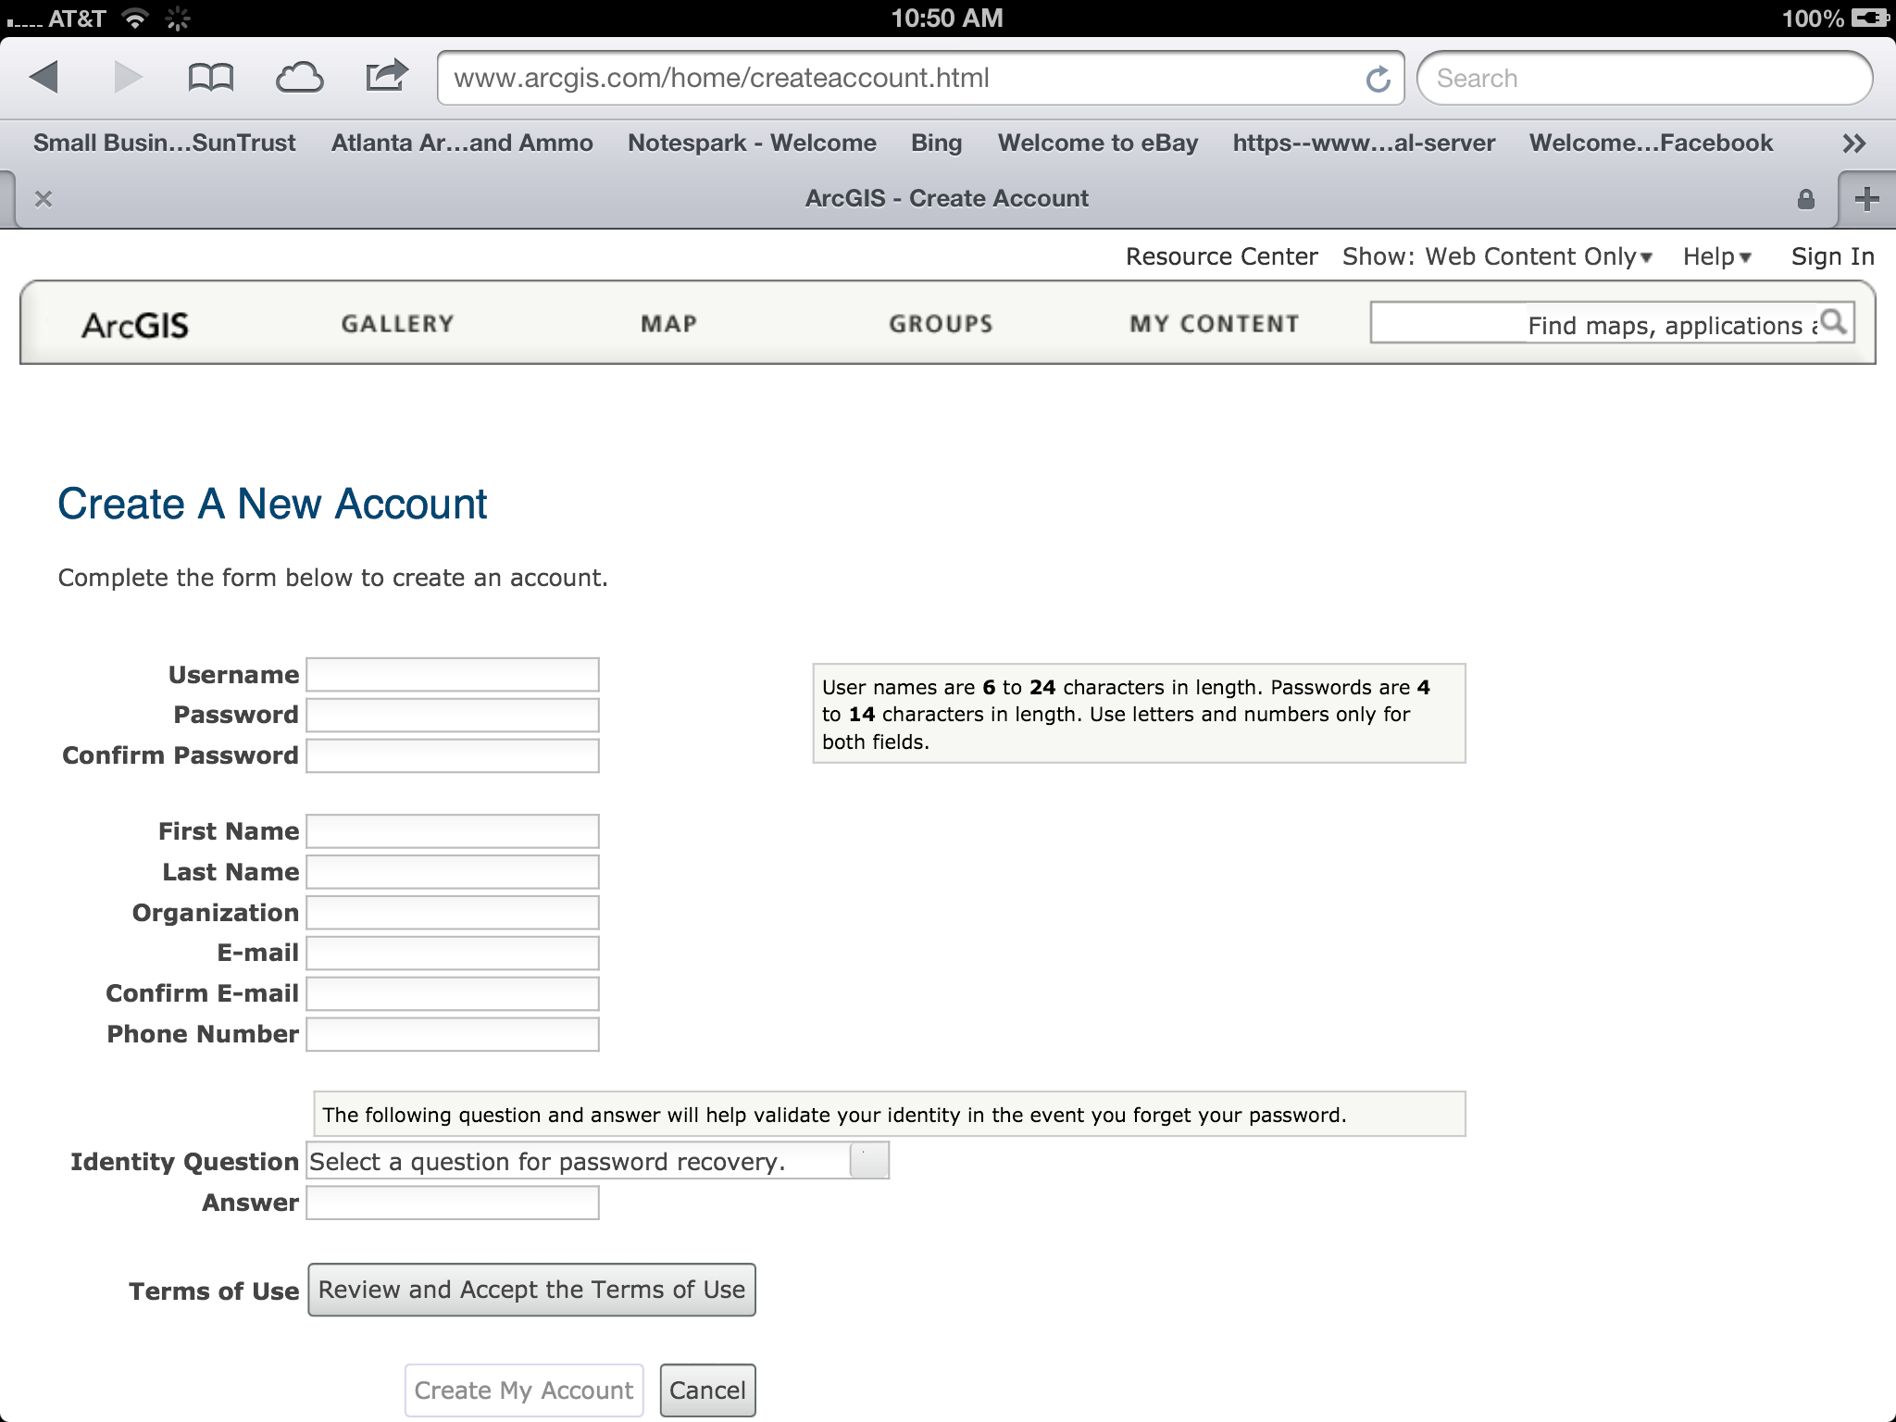
Create & Sign In to Account

Slide 20
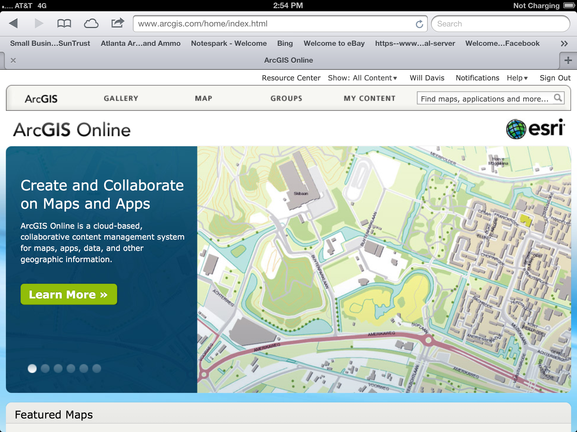
Confirm that you are Signed In

Slide 21
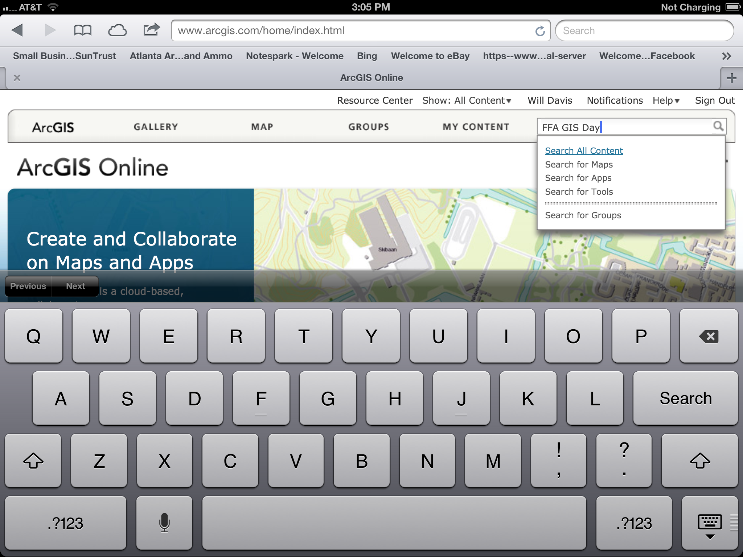
Select “New Map” at top left in ArcGIS Explorer Online

Slide 22
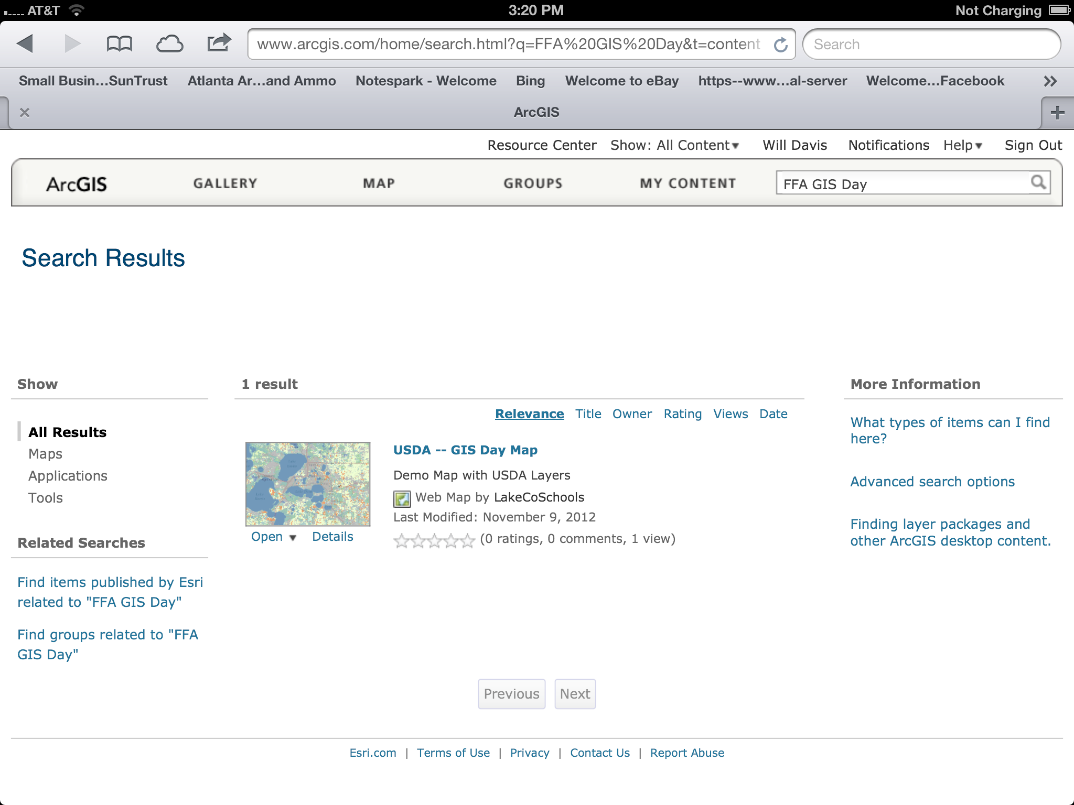
Search Results Page
Click
Here

Slide 23
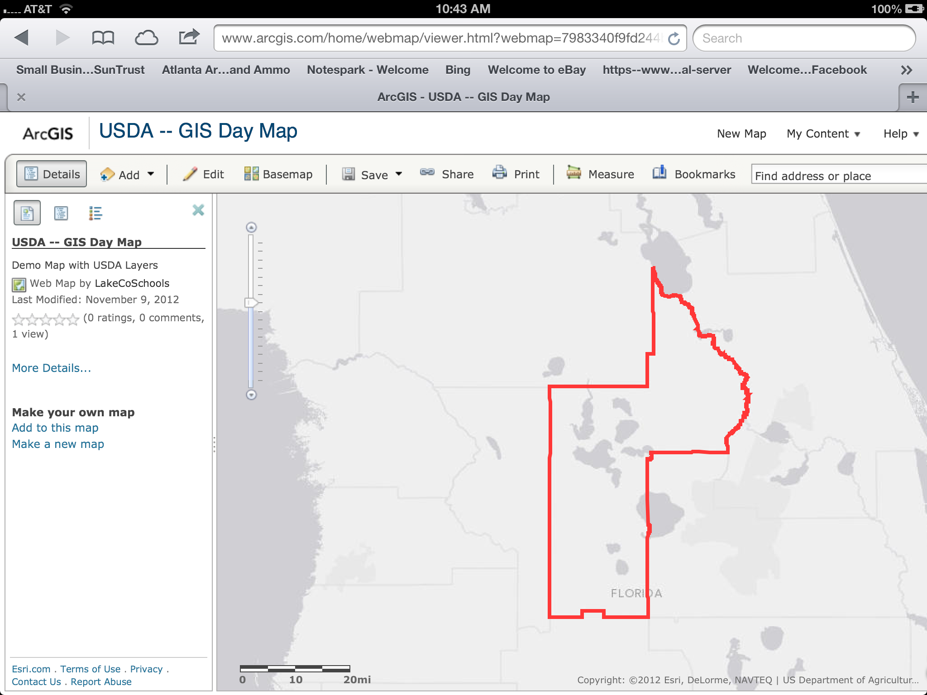
Map Details

Slide 24
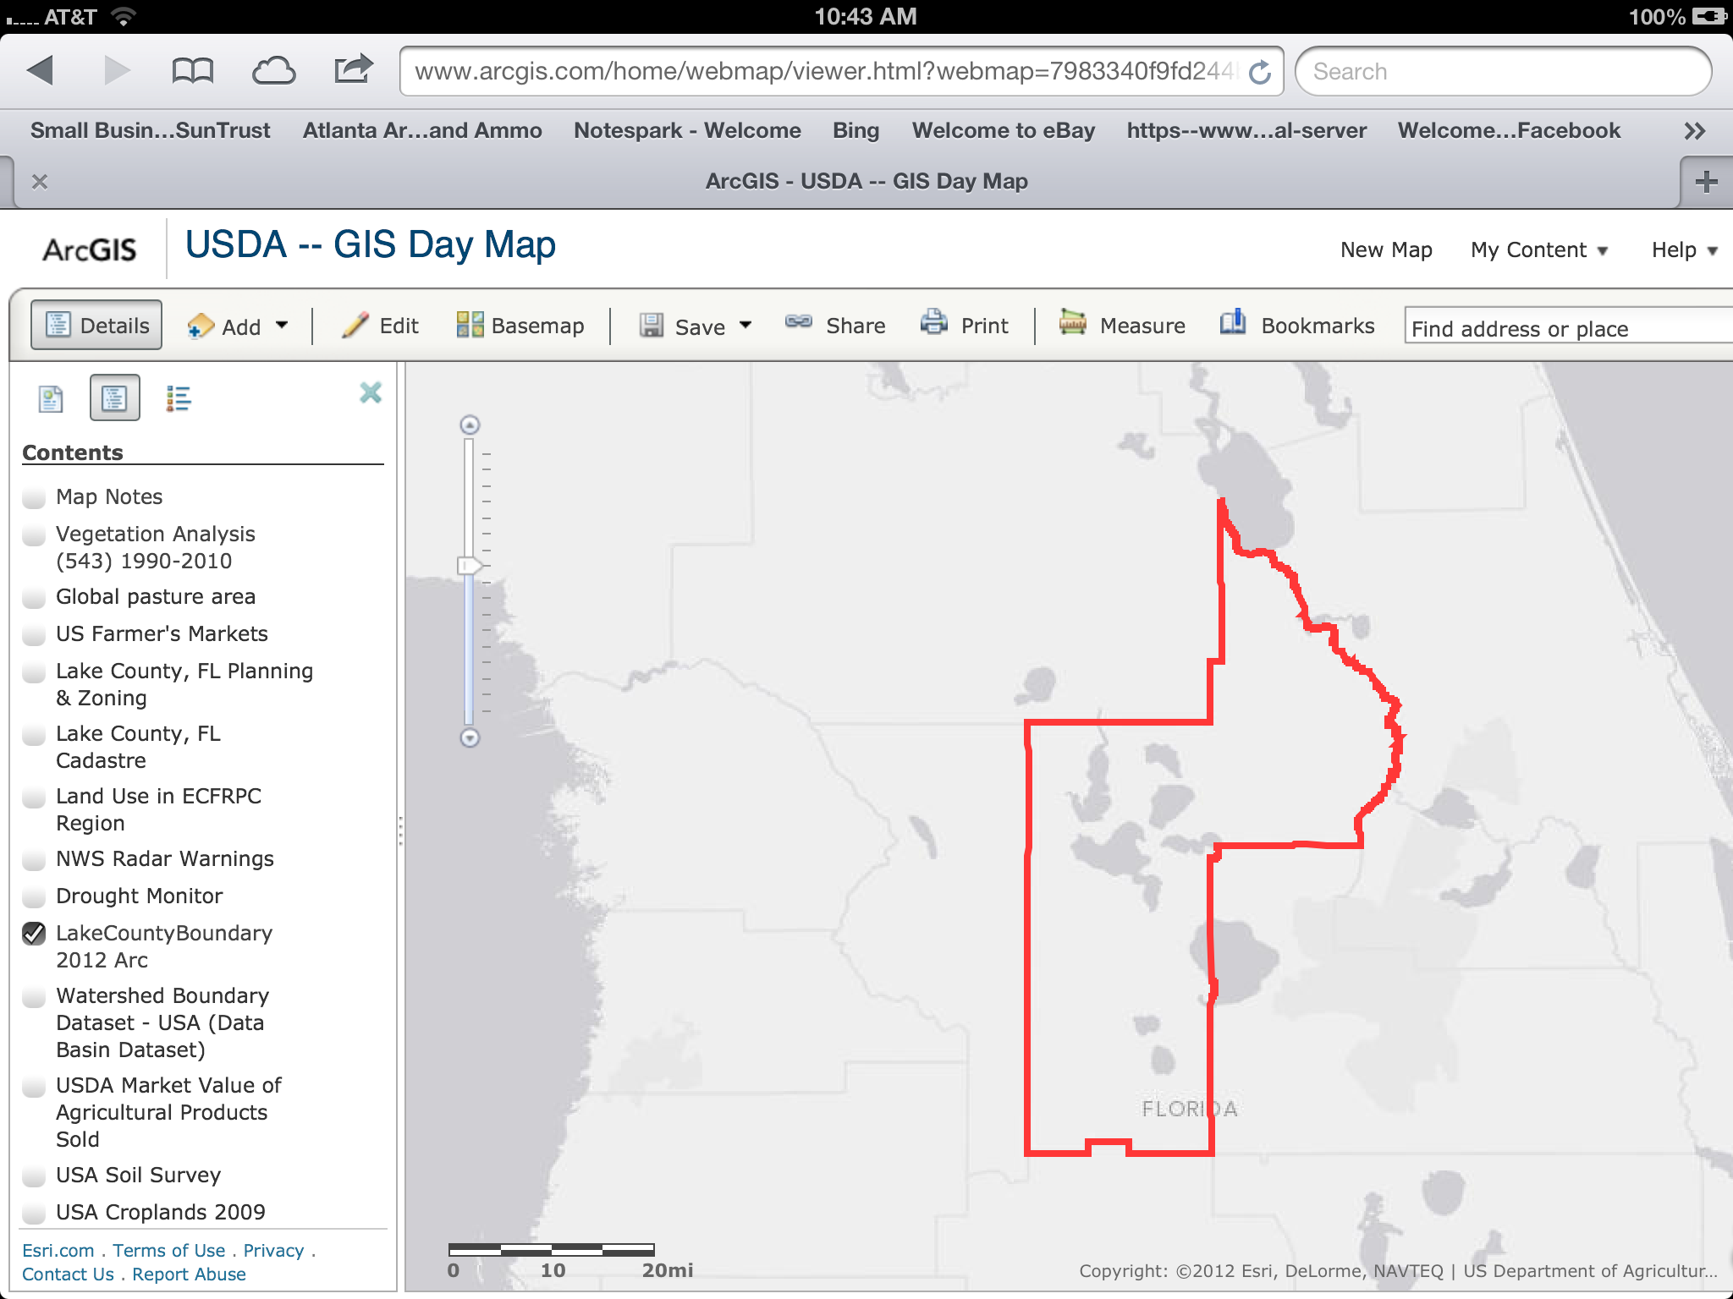
Map Layer Control

Slide 25
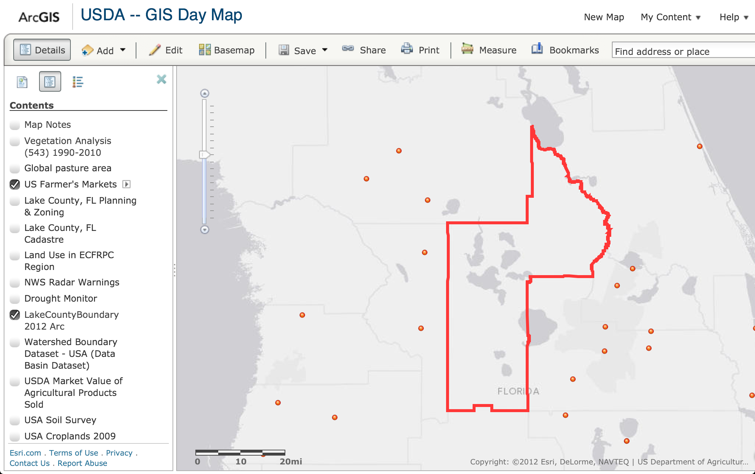
Map Layer Control Results

Slide 26
Feature Identification

Slide 27
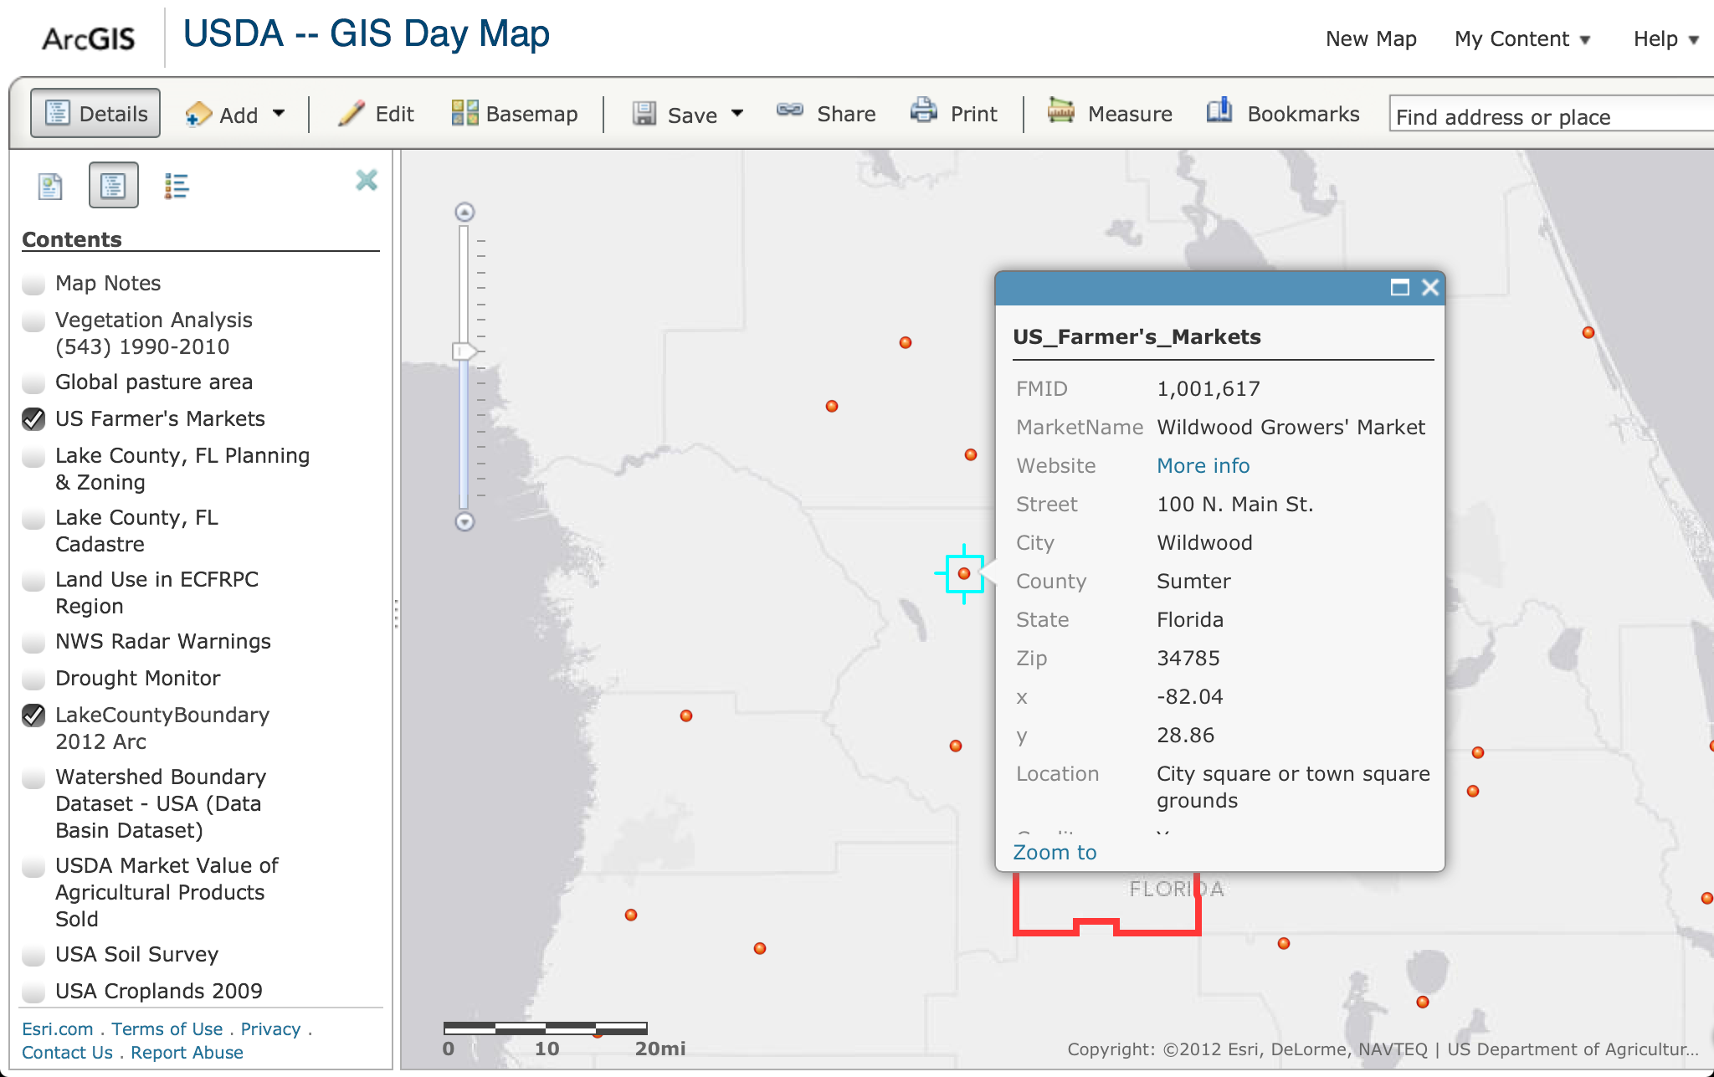
Attribute Table Popup

Slide 28
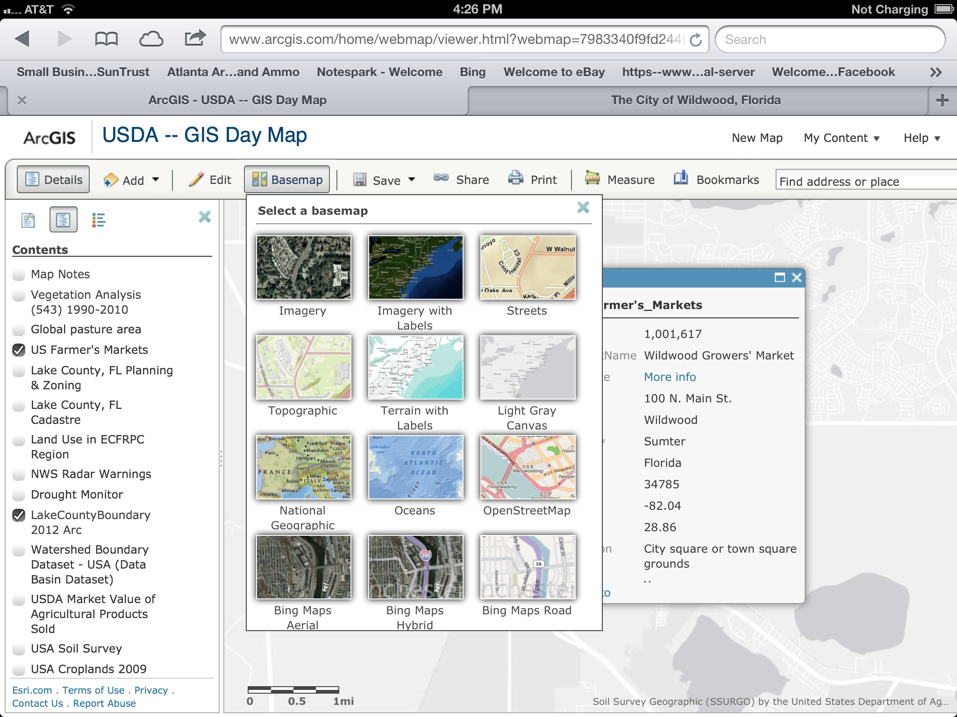
Basemap Options

Slide 29
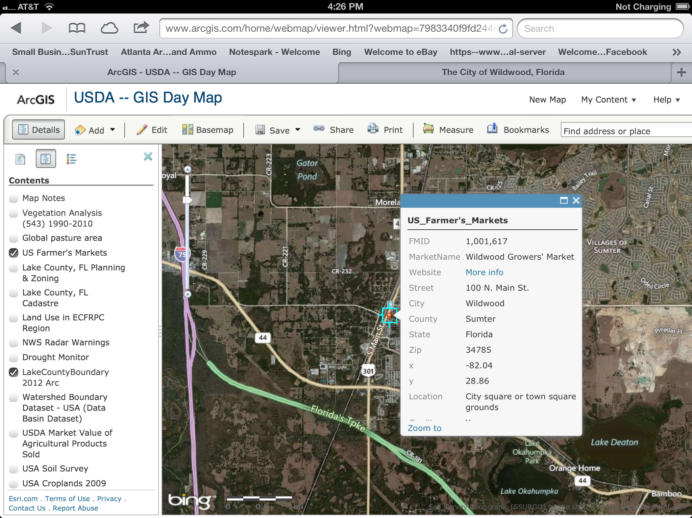
Basemap – Bing Maps Hybrid

Slide 30
Map Tool Bar
Add Data, Edit Feature or Change Base-map
Share, Print, measure or Save Map
Search for Places or Add bookmarks

Slide 31
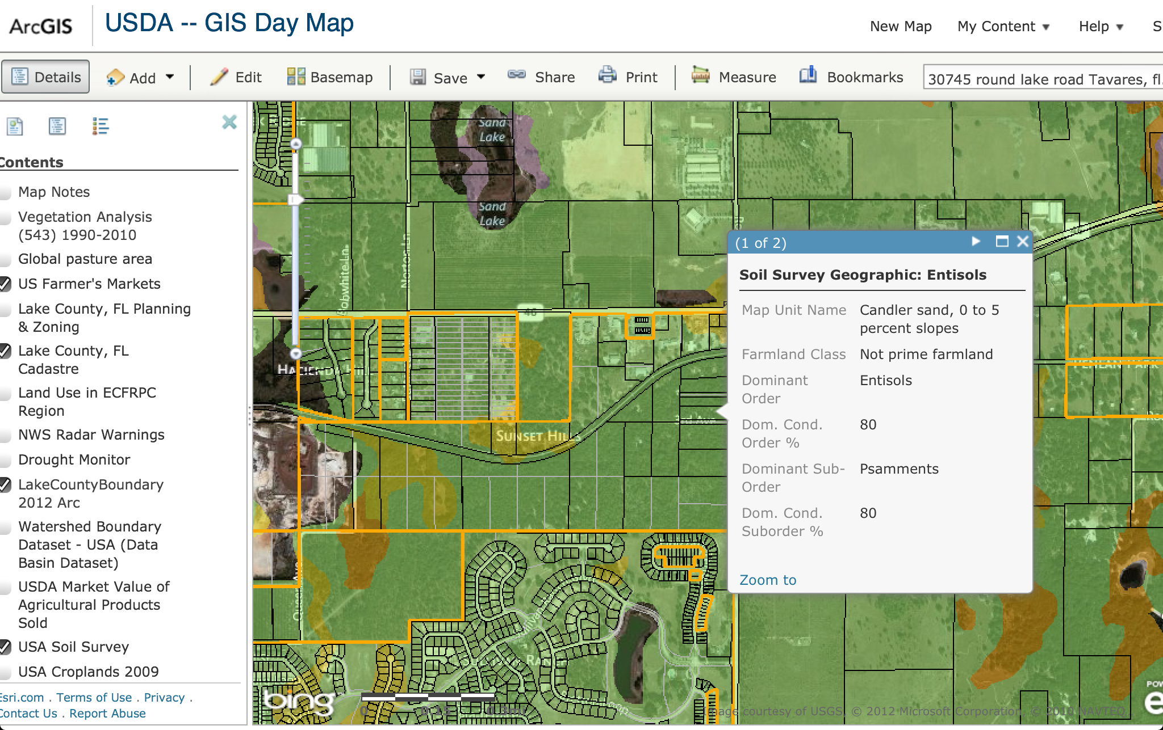
Map Viewer Freestyle
Use the Find address or place and type in your home address
Turn on the Lake County, FL Cadastral layer
Turn on the USA Soil Survey Layer
Select the screen for the Soil Survey Layer where your house is
Does your house sit on what is considered “Prime Farmland”?

Slide 32


