Slide 1

Defining the Puzzle Pieces of a School District GIS System
Will Davis, GISP & Harry Fix, AICP
Lake County Schools

Slide 2


Organizational Level’s Use of GIS?
Not sure
Planning & Student Assignment
Transportation & Student Routing
Planning & Student Transportation
Other Additional Departments
Aa
Bb
Cc
Dd
Ee

Slide 3
What is your level of GIS knowledge?
Have only heard of it in passing
Seen others use it before (intrigued)
Have a good working knowledge
I consider myself an expert or power user
Have a basic knowledge of its capabilities
Aa
Bb
Cc
Dd
Ee

Slide 4
Has GIS paid for itself in your organization?
We don’t currently use GIS
GIS has been a negative drain on our efforts
GIS is most likely a break even proposition
GIS has been a positive asset for the effort
The benefits don’t outweigh the cost/effort
Aa
Bb
Cc
Dd
Ee

Slide 5
Effective Organizational Use of GIS?
We currently don’t have GIS with no interest to use it
Don’t have GIS but currently looking with interest
We make full use of GIS in many departments
Consultants do most of our GIS work
We use it, but not nearly to its full potential
Aa
Bb
Cc
Dd
Ee

Slide 6
Points of Discussion
What is it and why do I need it
Realistic benefits
What can I do with it
Goals for implementation
Management & operational issues
What essentials do I need to start
Where do we get started
How can my District best utilize it

Slide 7
What is GIS?
GIS is an abbreviation for “geographic information systems” which is a set of tools that captures, stores, analyzes, manages, and represents data that are linked to locations. In the simplest terms, GIS is the merging of cartography, statistical analysis, and database technologies to develop better solutions and make better decisions.

Slide 8
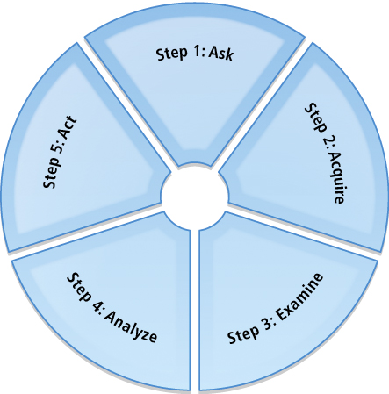
What is Geographic Approach?
Frame the question
Find the data
Examine the data
Analyze the data
Share the results

Slide 9
Why do I need GIS?
Pictures are worth a 1,000 words
  Absorb large amounts of data quickly
  Rapidly visualize complex data & ideas
Visual-spatial learners
  We tend to think in pictures rather than words
  63% of us are right brain thinkers

Slide 10
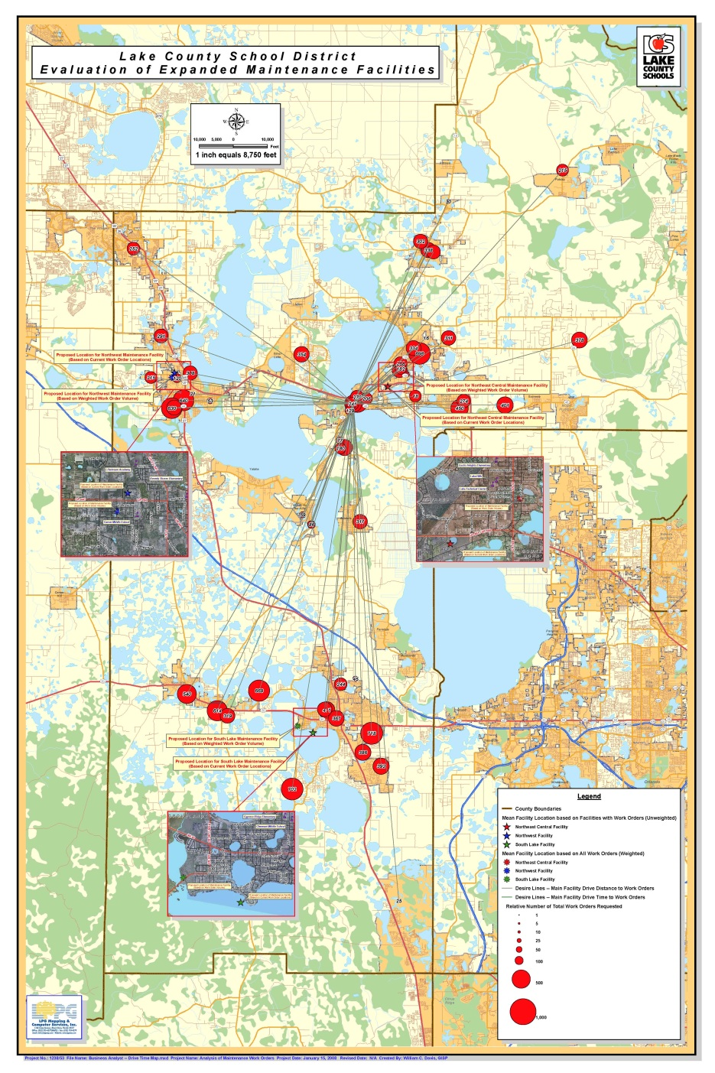



An Example of Picture is Worth a 1,000 Words

Slide 11
Why do I need GIS?
Geospatial reasoning & spatial awareness
  Three-dimensional mental models
  Forth-dimension of time
  Recall previously observed objects (object location memory)
  Integrate observation-based learning (separating objects by location or area)
  Understanding spatial context (right/wrong space)
  Recognition of spatial schemes (patterns & shapes)

Slide 12
Top Five Benefits to Using GIS?
Cost Savings and Increased Efficiencies
Better Decision Making
Better Recordkeeping
Managing Organization Geographically
Improved Communications

Slide 13
What Can You Do with GIS?
Map where things are (visualize patterns)
Map quantities (quantities by location or criteria)
Map densities (feature size & distribution)
Find what is inside (buffers or drive-times)
Find what is nearby (proximity awareness)
Map change (anticipate the future or evaluate the past)

Slide 14
PART 1 -- Target Goals of Implementing GIS!
Improved efficiencies
Effective management of resources
Automate workflow processes
Comply with regulatory mandates
Improve communication, coordination and collaboration
Increase productivity
Improve data accuracy & processing

Slide 15
PART 2 -- Target Goals of Implementing GIS!
Improve data accuracy & processing
Save time
Make better quality & more effective decisions
Save money
Share data resources with others
Improve information processing
Respond quicker to stakeholder request

Slide 16
PART 1 - Management Issues to be Considered!
Leadership (who's carrying the torch)
Plan (Strategic Implementation Plan)
Cost (manpower & technology)
Responsibility & Accountability
Data availability
Timeframe
Organizational Cooperation
  Internal (IT Department)
  External (state, regional & county)

Slide 17
PART 2 - Management Issues to be Considered!
Communications
Development vs. maintenance
  Internal (District staff)
  Consultant(s)
Build tools to enable end users
Return on Investment (ROI)
Cost Benefit Analysis (CBA)
NOTE: CBA means everything is essentially translated into dollars — the inputs and the outputs, where ROI represents money saved, is contrasted with the amount of money spent on the program.

Slide 18
Operational Things to be Considered!
Availability of existing data
Accuracy (scale)
Geographic reference (grid)
Target Audience
  Internal (staff)
  External (public, parents & community stakeholders)
Development priorities
Centralized or decentralized
Onsite infrastructure

Slide 19
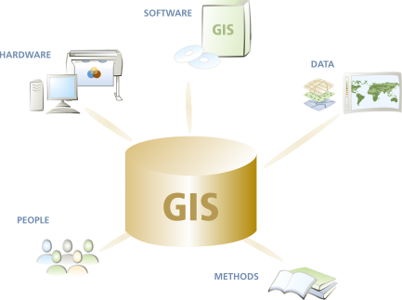
What are the parts of a GIS?
Hardware
computers, printers, servers
Software
programs, applications
Data
information, tables,
spreadsheets, databases
Methods
how to ask questions
People
creaters & end users

Slide 20
Integrating the Parts to see the BIG Picture!
Students, Facilities or Addresses
Transportation Zones
Streets & Bus Routes
School Attendance or Student Analysis Zones
Tax Parcels, Facility or District Ownership
Aerial Photography
Reality

Slide 21
What are the Most Important Puzzle Pieces?
Data, Data, Data
  Internal
    Who has it
    Can we extract it out
    Can we import it back in
    Is the quality acceptable
  External
    Base-feature elements
Hardware
  Onsite
  Cloud
Software
  Proprietary
  Open source
Methods/People

Slide 22
DATA – The Most Important Puzzle Piece!
Student data
  Usability
  Exportable/importable
  Accuracy
  Easily accessible
  Able to geocode
Tax parcel boundaries
E911 addresses
  Point
  Polygon
Road centerlines
  Network routable
  Address ranges

Slide 23
How Do We Get Start?
Determine priorities
  Strategic Implementation Plan
    Needs assessment
    Conceptual design
    Survey of available data
    Survey of hardware & software
    Database planning & design
    Database construction
    Pilot study & benchmark testing
    GIS system integration
    GIS application development
    GIS use and application
  Database planning
    Local
    Corporate
  Identify participants
    Developers
    Analyst
    Users

Slide 24
Starting with Transportation
Transportation Department
  Student geocoding
    Address points
    Street centerlines (address ranges)
  Create facility & critical points
    Schools
    Bus stops
    Transportation depots
    Facility access points
      Bus
      Staff
      Parent pickup & drop-off
      Pedestrian
  Networkable street layer
    Purchase license (NAVTEQ)
    Obtain or create from local government
  Other important data lookup tables
    Vehicle
    Driver

Slide 25
Starting with Planning
Planning Department
  Student geocoding
    Address points
    Street centerlines (address ranges)
  Create facility & critical points
    Schools
    Administrative
  Planning boundaries (from tax parcels)
    Student Analysis Zones (SAZ’s)
      Utilized existing boundaries as template
      Evaluate against other local government boundaries
        Transportation Analysis Zones (TAZ’s)
        Census Blocks
        Local planning areas
    Attendance zones (built from SAZ’s)
  Student export tables
    Student assignments
    Zone status
    Add in transportation boundaries (if available)

Slide 26
How can GIS be utilized in my District?
Planning
Transportation
Facilities Department
Information Technology Department
Finance Department
Safe Schools

Slide 27
Planning Department
Student demographic analysis
Facility siting
  SREF (State Requirements for Education Facilities)
  Redistricting assessments
  Transparency of assessment process
Growth projections
  Residential density changes
  Areas of growth projection potential
  Future transportation issues
  Local government collaboration
Student & program assignments

Slide 28
Transportation Department
Student locations & mapping
  Primary residence
  Secondary pickup and drop off sites
  Category assignments (HWR, PRZ & FTE)
Depot facility siting
Transportation logistics (routing)
  Student bus stop assignment
  Bus stop assessments
    Safety
    Location
    Distance
  Routing efficiencies & optimization
  Sexual Predator / Offender
Customer service

Slide 29
Information Technology Department
Student Information Systems
  General automation
  Record audits
  Attendance assignment
  Student eligibility
  Transportation FTE & HWR
  Zone waiver accountability

Slide 30
Facilities Department
Construction management
  Design visualization
  Site limitations (physical & environmental)
  Track & record construction process
Physical plant
  Florida Inventory School Houses (FISH)
  Facility utilization
  Maintain site infrastructure
  Portability of information
Maintenance logistics
  Facility siting
  Cost of Ownership
  Efficient work order assignments

Slide 31
Finance Department
Mileage assessments
State & local budget comparisons
Charter school reimbursement
Financial assessments & comparisons

Slide 32
Safe Schools
Emergency planning & preparation
Law enforcement coordination
Depiction of incident
Staff resource allocations
Tracking sexual predators/offenders

Slide 33
Things to Remember about GIS
Great tool for getting your message out
Produces quantifiable results
Gain efficiencies
Save both time & money
Has functional purpose organization-wide
KISS -- Start slow and gain momentum
Don’t work within a vacuum

Slide 34

Presentation Takeaway

Slide 35

QUESTIONS

Slide 36

Contact & Presnetation Information
Will Davis – DavisW@lake.k12.fl.us

