Slide 1
Unlocking the Magic of GIS for use with STEM
Will Davis, GISP
Operations, Lake County Schools

Slide 2
Pondering Question: What is GIS and why is it important in education?
Notes:
2

Slide 3
STEM: Science Technology ??????? Engineering Mathematics
Notes:
3

Slide 4
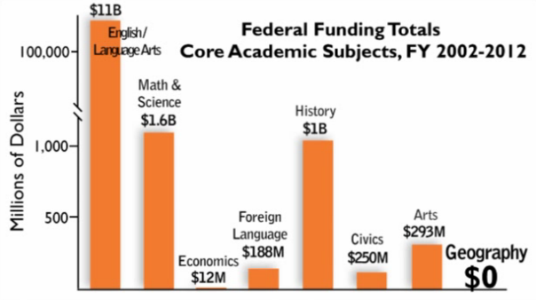
Federal Funding of Core Academic Subjects
Notes:
4

Slide 5
STGEM: Science Technology Geography Engineering Mathematics
Notes:
5

Slide 6
Question - Part 1: What is GIS?
Notes:
6

Slide 7
Geographic Information Systems
GIS is an abbreviation for geographic information systems which is a set of tools that captures, stores, analyzes, manages, and presents data that are linked to locations. In the simplest terms, GIS is the merging of cartography, statistical analysis, and database technologies to develop better solutions and make better decisions.
Notes:
7

Slide 8
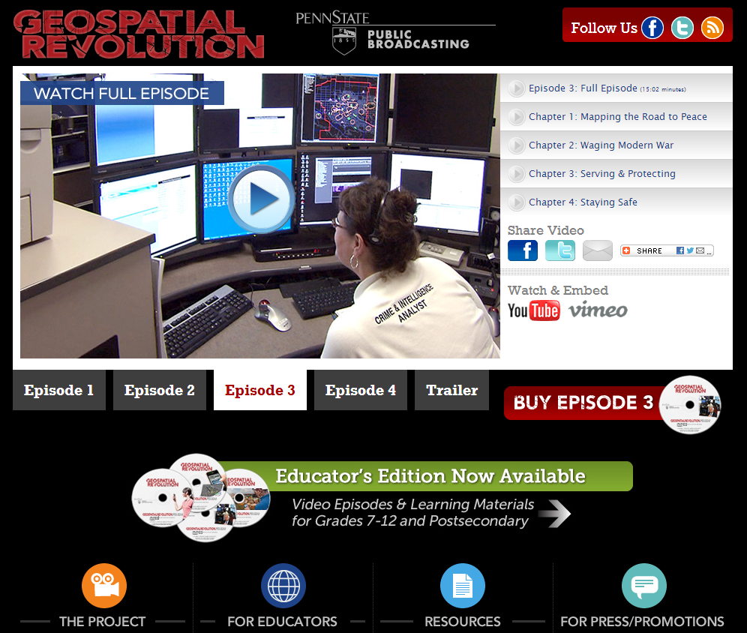
Geospatial Technology from Penn State University (Geospatial Revolution Project)

Slide 9
How does GIS fit into STEM?
Critical thinking
Cross-disciplinary problem solving
Academic to real-world concepts
Pathway for deciding best solutions
Problem-based learning (PBL)
Motivation with technology
Builds workforce ready skills
Growing demand in job market

Slide 10
Student Motivation with Technology
“I’ve rarely seen 100% engagement in any lesson activity as I have with ArcGIS Explorer Online. It was a great success!”
Diane Reid-Goolsby,
6th Grade Geography Teacher
Tavares Middle School

Slide 11
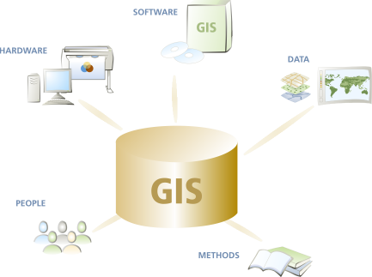
What are the components of GIS?
Hardware
computers, printers, servers
Software
programs, applications
Data
information, tables,
spreadsheets, databases
Methods
how to ask questions
People

Slide 12
Infrastructure Requirements
Computer hardware
Network connectivity
Educator knowledge & experience
Circulum materials available
Acquired an educational site-wide license
+30 license platforms with unlimited use
Desktop, server, tablet & smartphone platforms
Mobile (IOS, Windows Mobile & Android)
Business & community analyst applications
Cloud-based applications with ArcGIS Online

Slide 13
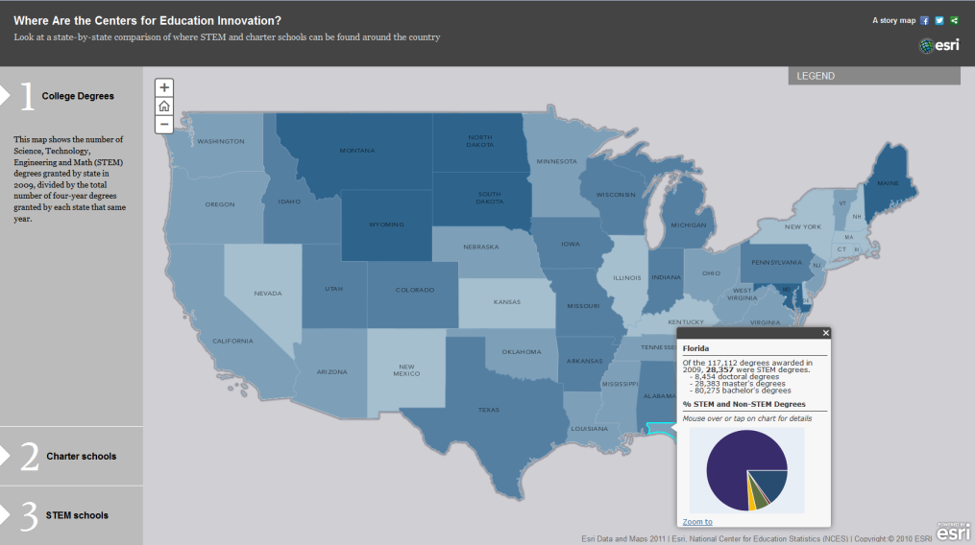
Infrastructure Requirements
Circulum & informational materials available
National Science Foundation (NSF)
U.S. Geological Survey (USGS)
National Geographic Society – Geo-Literacy Project
Institute for the Application of Geospatial Technology (IAGT)
GIS & Science Blog
ESRI or GIS.com
GIS2GPS Portal
Slideshare
District‘s site

Slide 14
Moving the Bar Forward

Slide 15
Question – Part 2: Why is it important? (to student learning & success)
Notes:
15

Slide 16
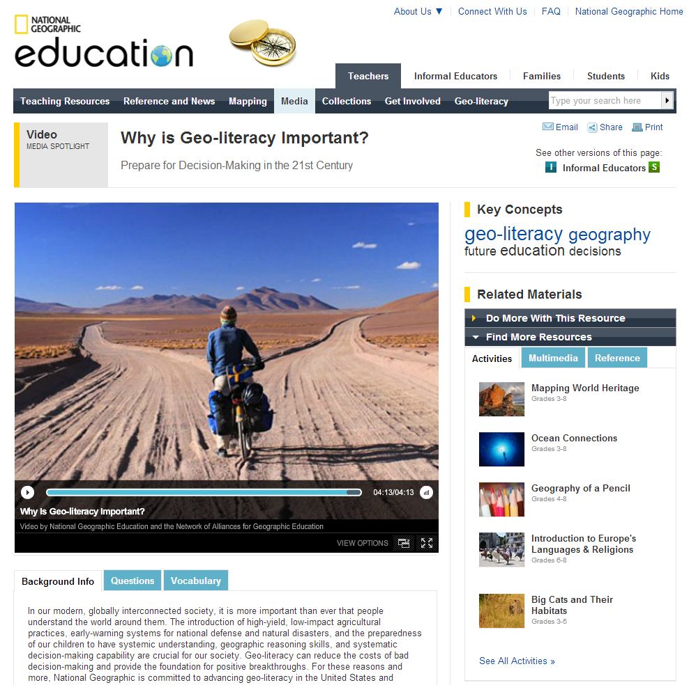
Geo-literacy from National Geographic (Preparing for Decision-Making in the 21 Century)

Slide 17
Learning Important Skillsets
Critical thinking
Cross-disciplinary problem solving
Connects STEM‘s focus discipines
Real-world concepts
Pathway to best solutions
Problem-based learning (PBL)
Great motivational tool
Involves latest technology

Slide 18
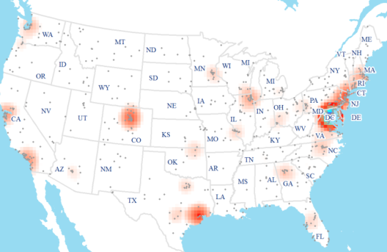
What is the GIS Job Market?
Industry grew by double digits in early 2010‘s
Is considered a “high growth industry“ (Dept. of Labor)
Expected annual growth of 35% each year through 2020
Florida was 4th of top 10 job postings states in GIS
Can earn an annual salary of up to $70,000
GIS Analyst (Information Technology Sector) rank in top 100 of Best Jobs in America (CNN Money)
Diversity of available jobs based on all educational levels

Slide 19
Types of jobs that use GIS
Computer Science
Electric/Gas Utilities
Business/Marketing
Telecommunications
Transportation Logistics
Petroleum & Mining
Engineering
Water & Wastewater
Health Care
Federal Government
Economics
Environmental Mgmt.
Local Government
School Districts
Geology
Military/Intelligence
Archeology
Sociology
Community Planning
Real Estate & Cadastral
Agriculture
Forestry
Public Safety
Risk Management
Aerial Photography

Slide 20
Presentation Takeaway
Activate GIS

Slide 21
Questions

Slide 22
Contact & Presentation Information
DavisW@lake.k12.fl.us / Ext. 6527
QR Code to Download PDF Version of Presentation

