Slide 1
Lake County Schools
Will Davis, GISP
Lake County Schools
Tampa Bay GIS Group
Monday, November 9th, 2015

Slide 2
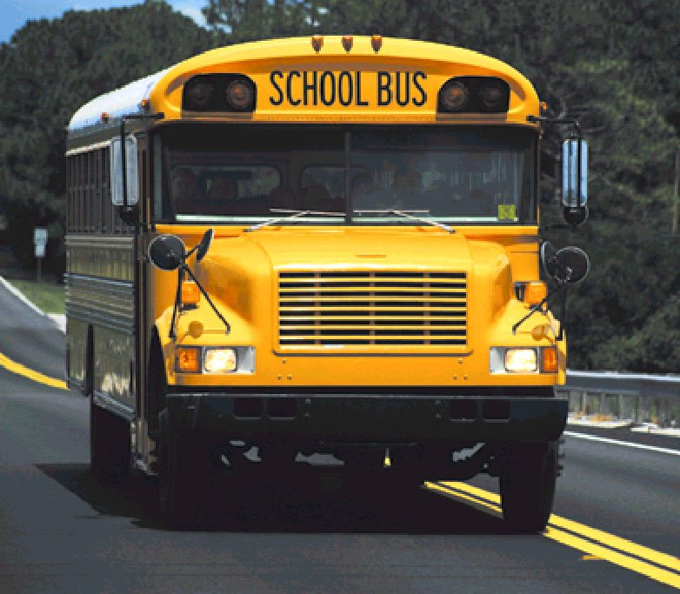
The Big Yellow Bus

Slide 3
Background
±250 Buses in Regular Service
Transporting 20,762 Students
Twice Daily
30,658 Miles

Slide 4
Background
Key West, FL to Deadhorse, AK
Distance of 5,489 -- 3 Days 23 Hours (w.o.t.)
30,658 Miles = 2.6 Round Trips
6.2 mpg = 4,950 gallons/day
Fargo, ND

Slide 5
Background
Annual Distance Traveled
5,518,481 Miles
(11.5 Round Trips)
238,900 Miles
Notes:
Average Space Shuttle Mission was 4,320,000 miles traveling 17,000 miles per hour and circling the globe every 90 minutes. Average time in space is two weeks. Shortest distance to mars is 34.8 million, therefore it would take us 6 years and four months to reach it in a bus.

Slide 6
Background
Revenue/Expenditure Shortfall
Expenditures = $16 million
Cost to district = $8.2 million
State reimbursement = $7.8 million
State vs. local = 51% vs. 49%
$1.26 million for 11 buses

Slide 7
Background
Statutory obligation to transport students
6A-3 F.A.C.
1006.21 F.S. to 1006.27 F.S.
8.30 to 8.39 School Board Policy
Historical transportation of all students
Started detailed 2-mile assessments (May 2008)
Board Workshops (March 2009)
Creation of PRZ for High Schools (July 2009)
Submitted hazardous conditions (September 2009)

Slide 8
Background
Completed 2-mile walk analysis (April 2009)
Walkable infrastructure assessment (August 2011)
PRZ’s for Elementary & Middle Schools (June 2013)
Locally hazardous conditions (October 2013)
Adopt 1-mile PRZ’s for Elementary (July 2015)
Community partners
MPO
LCBCC
Cities
Safety Committees -- BPAC & CTST

Slide 9
Routes Designations
Easily Walkable Zones (EWZ)
Areas depicted in GREEN
Hazardous Walking Routes (HWR)
Areas depicted in RED
Special Exception Areas (SEA/ST)
Areas depicted in GOLD (Short-Term)
Special Exception Areas (SEA/LT)
Areas depicted in PURPLE (Long-Term)

Slide 10
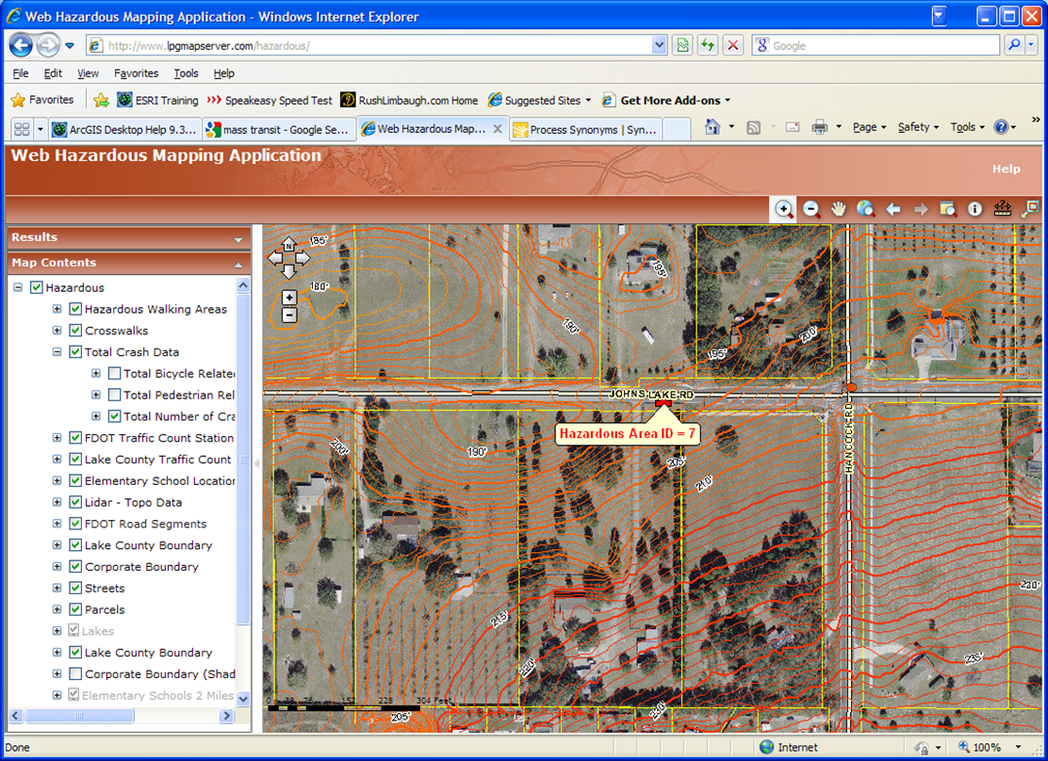
Phase 1 Review

Slide 11
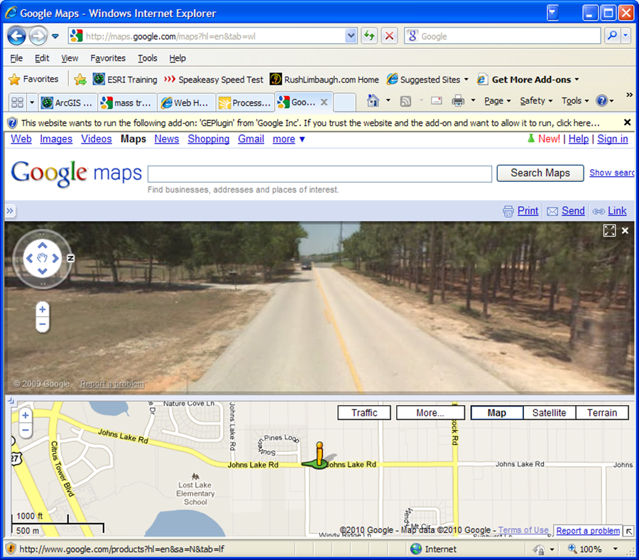
Phase 2 Review

Slide 12
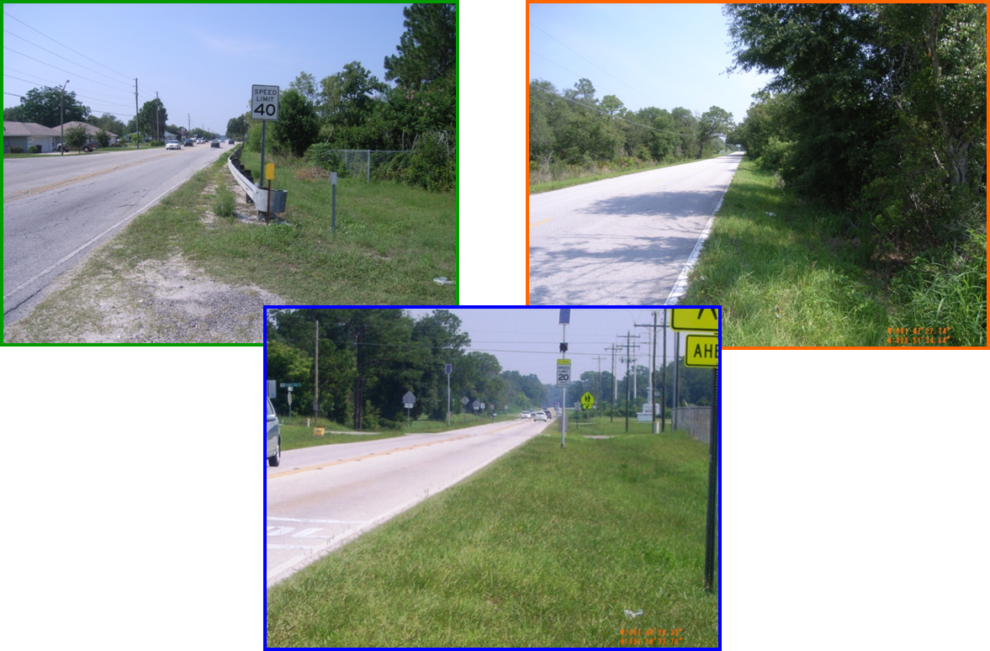
Phase 3 Review

Slide 13
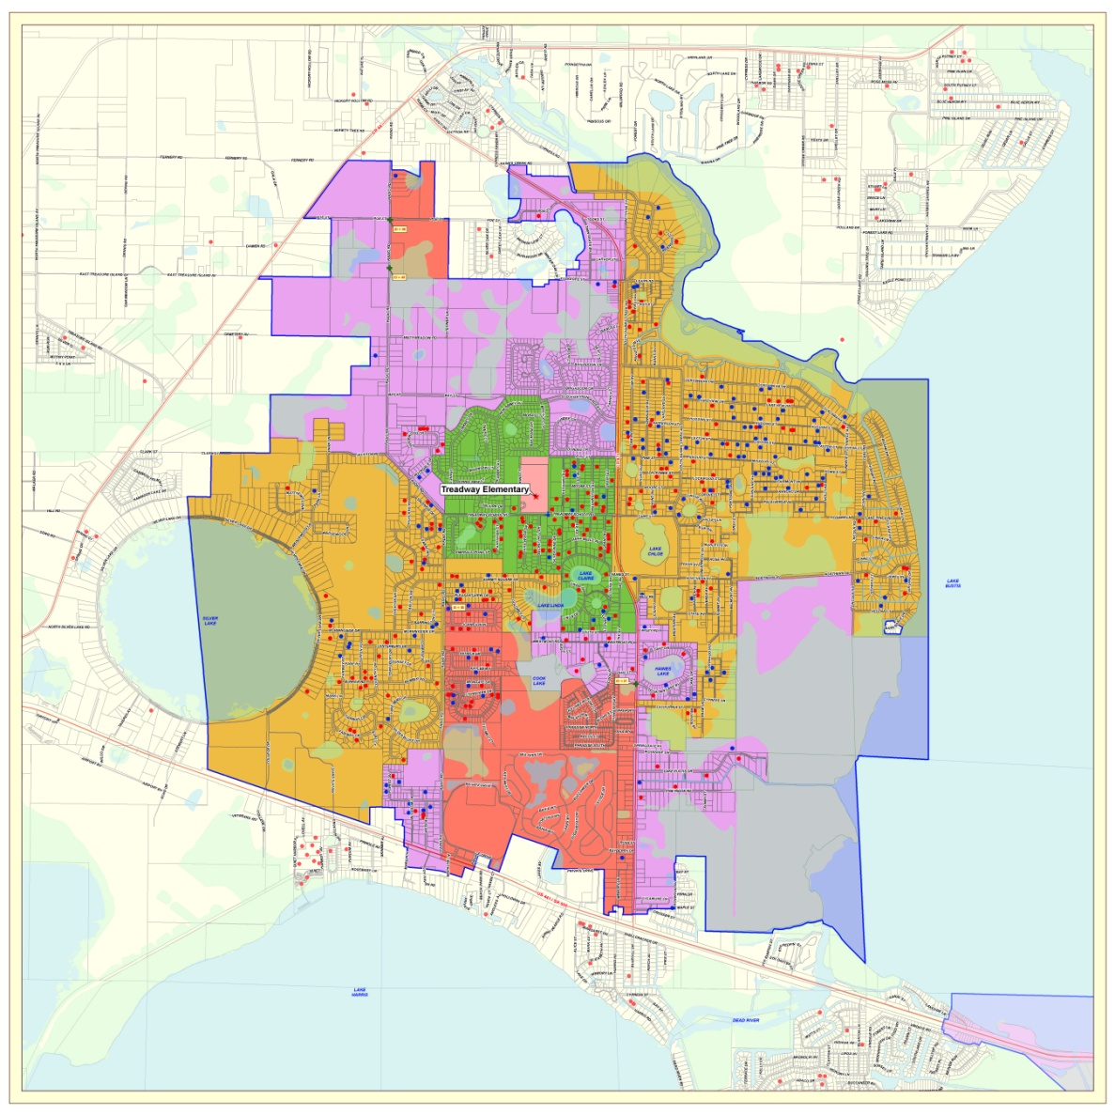
2-Mile Designations

Slide 14
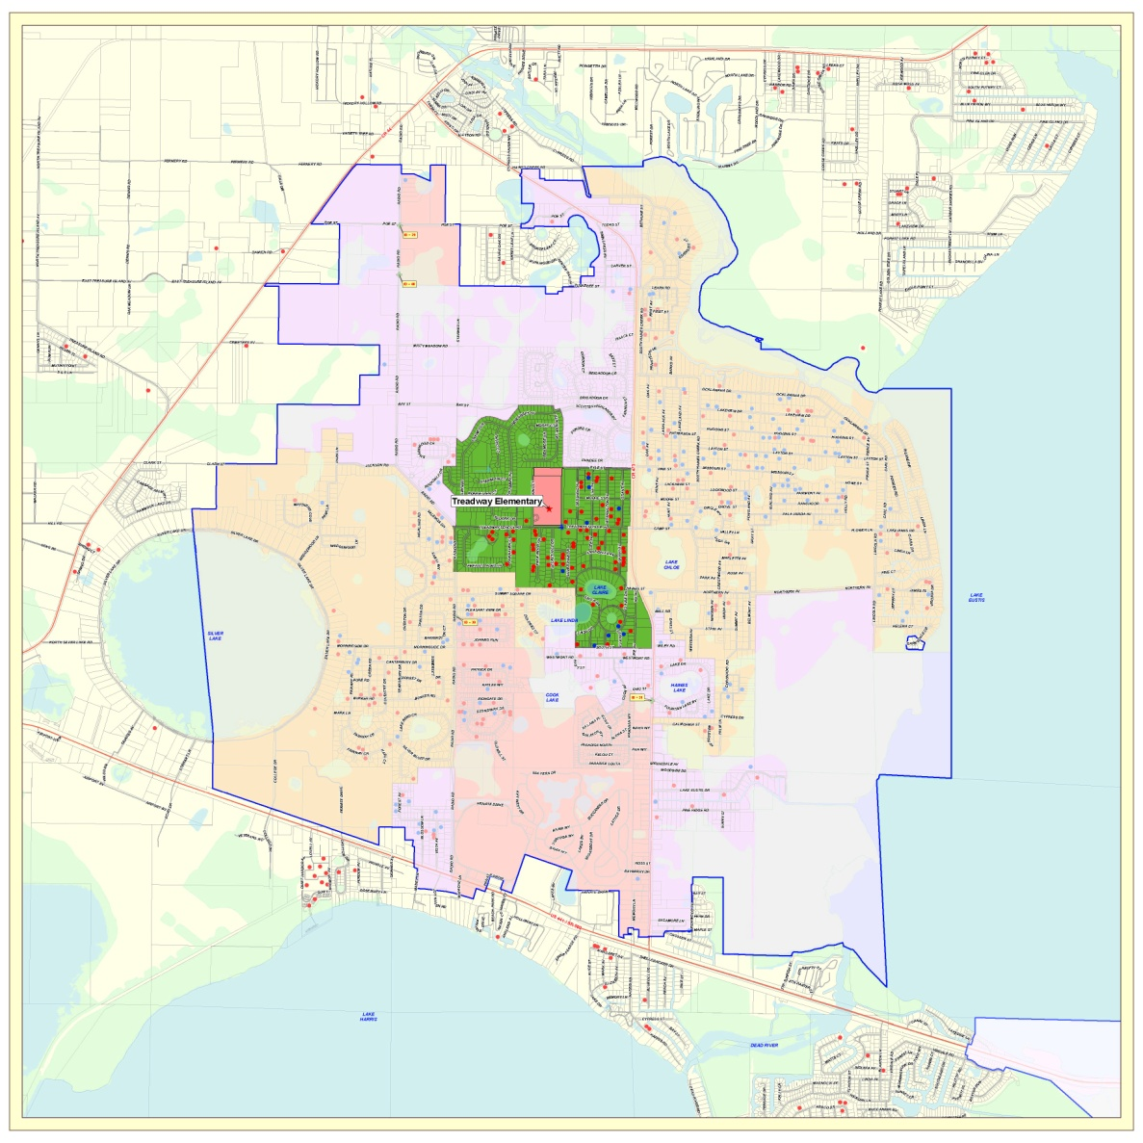
Walkable Zones

Slide 15
Walkable Zones

Slide 16
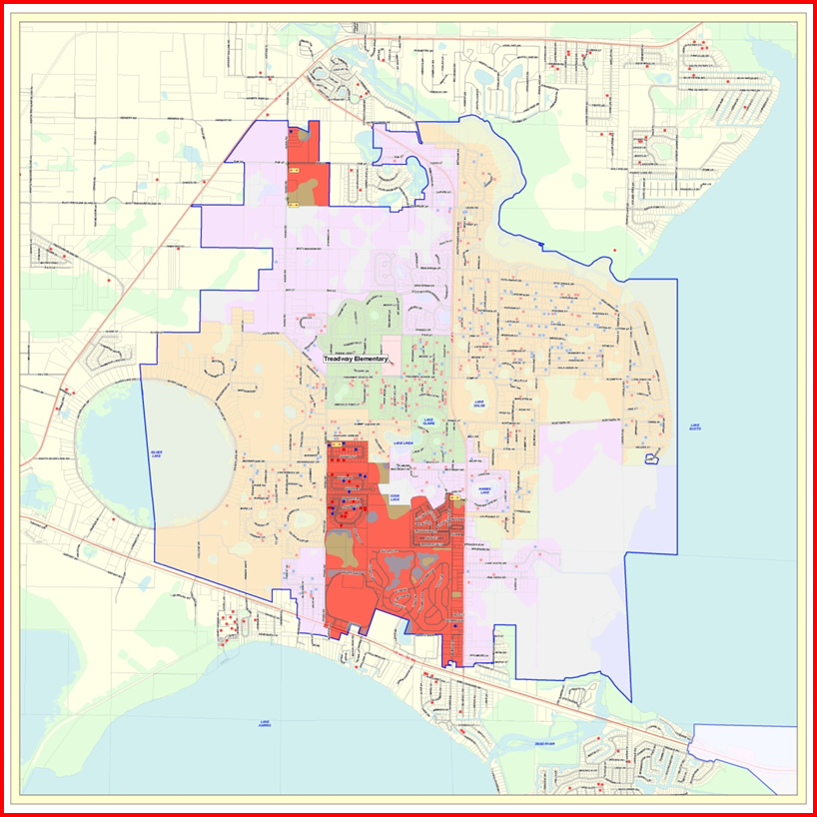
Hazardous Zones

Slide 17
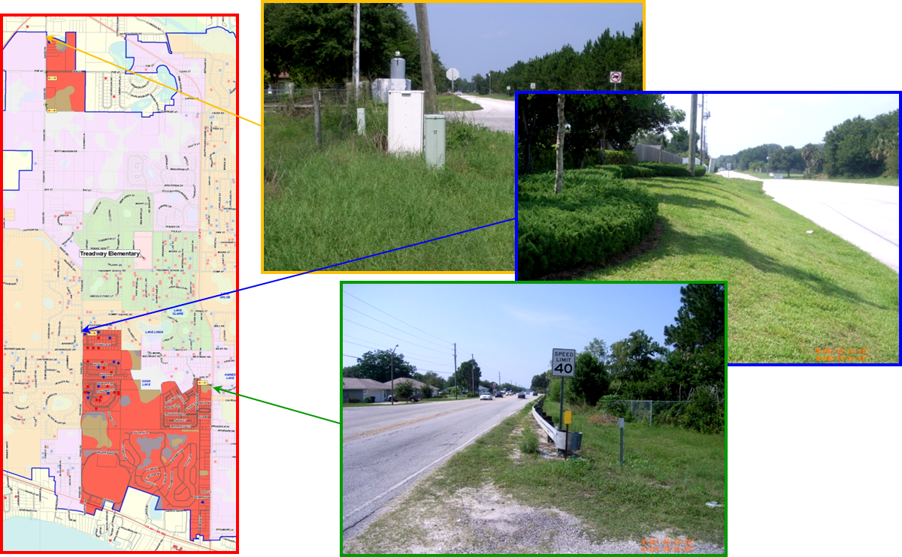
Hazardous Zones

Slide 18
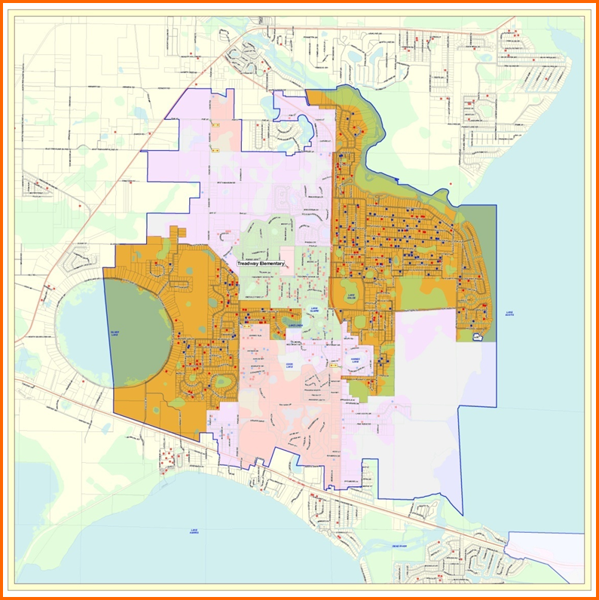
Special Exception (ST)

Slide 19
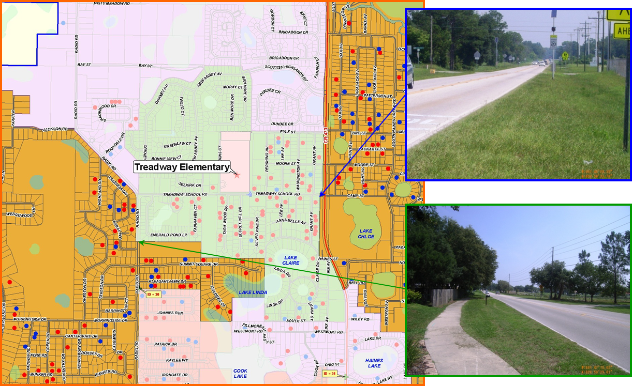
Special Exception (ST)

Slide 20
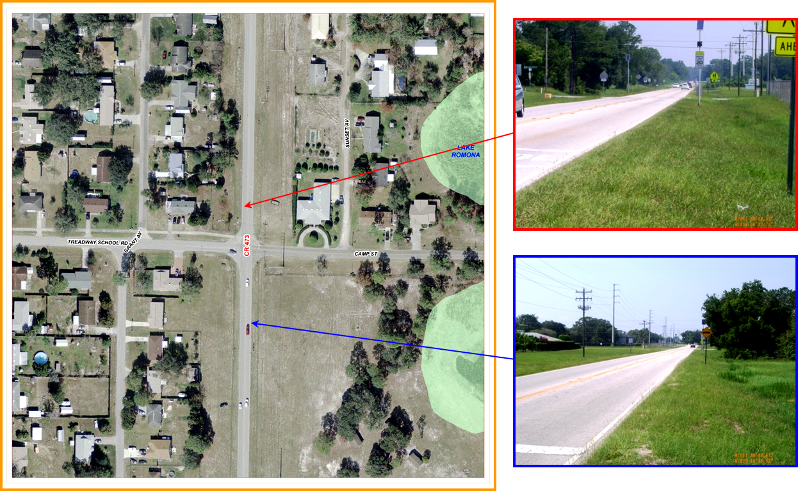
Special Exception (ST)

Slide 21
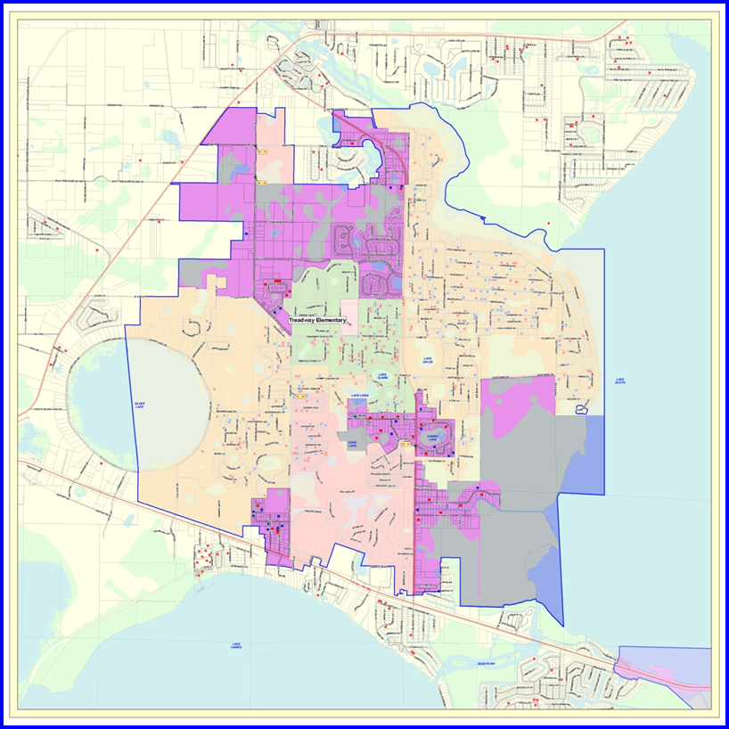
Special Exception (LT)

Slide 22
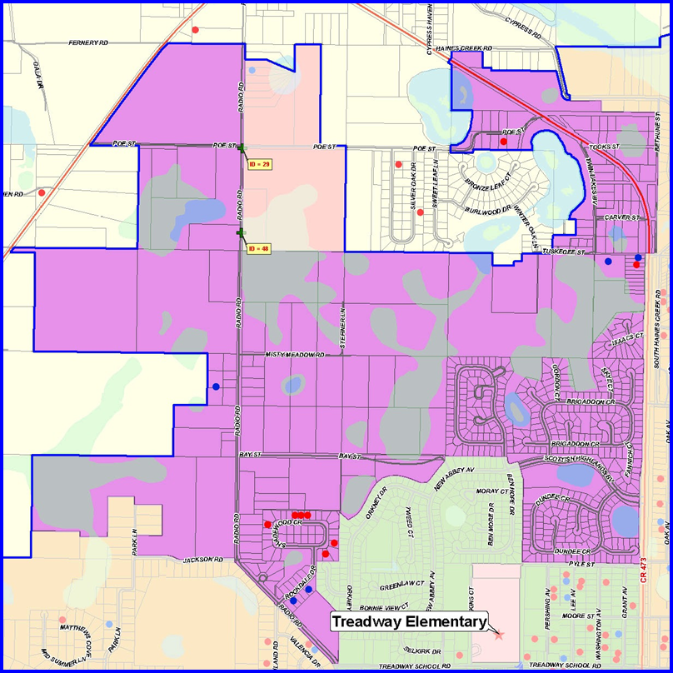
Special Exception (LT)

Slide 23
Walking Improvements
Identified 105 key areas
Improvement type (6)
Sidewalk install (65 or 62%)
Crossing guard or signalization (36 or 34%)
Routine maintenance (4 or 4%)
Condition type
Intersection (1 or 1%)
Right-of-Way (35 or 33%)
Crosswalk (69 or 65%)

Slide 24
Walking Improvements
Identified 105 key areas (cont.)
Impacted student riders (2,858)
Responsible agency
Maintenance
Law enforcement
Improvement cost (10-yr return)
$21.4 million
Improvement savings (10-yr return)
$20.3 million

Slide 25
Walking Improvements
Performed an ROI Analysis
Savings vs. cost
41 projects – negative return
64 projects – positive return
Top 24 ranked projects
+$250,000 positive return
MPO gap analysis

Slide 26
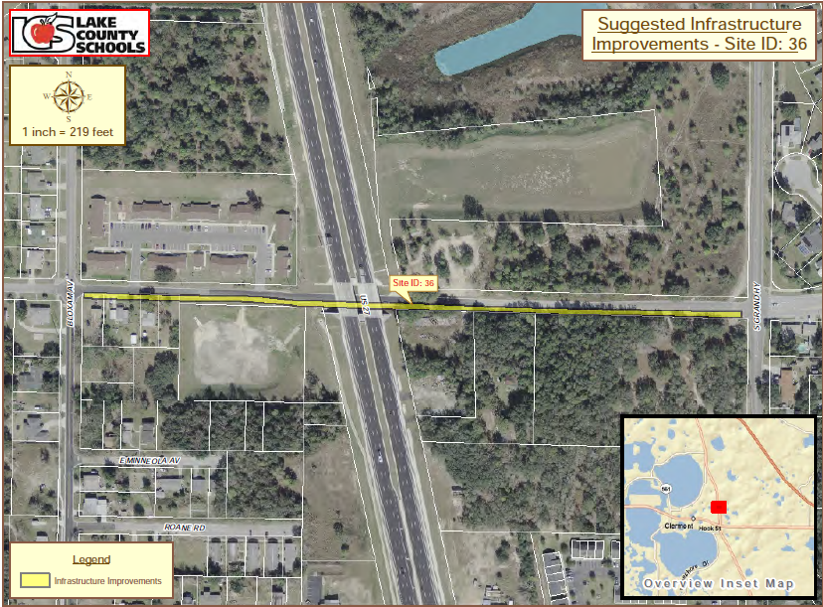
Sidewalk Improvement
Ranked 49th with ROI = $46,000

Slide 27
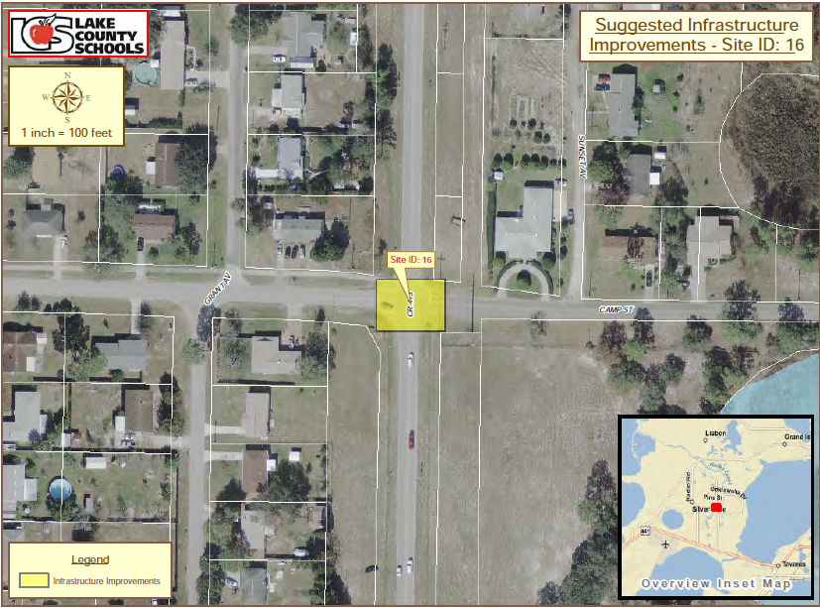
Crossing Guard
Ranked 2nd with ROI = $788,000

Slide 28
Questions
Will Davis -- davisw@lake.k12.fl.us

