Slide 1


GIS Day
Geography Matters™!

Slide 2

Where’s
Waldo?
Notes:
2

Slide 3
What Is Geography?
Geography is a science that enables us to find answers to questions about the world around us.
Geography helps us to locate where things are and how or why they are there.

Slide 4
What is GIS?
GIS is an abbreviation for geographic information systems which is a set of tools that captures, stores, analyzes, manages, and presents data that are linked to locations. In the simplest terms, GIS is the merging of cartography, statistical analysis, and database technologies to develop better solutions and make better decisions.

Slide 5
How does GIS fit into your Future?
Critical thinking
Cross-disciplinary problem solving
Academic to real-world concepts
Pathway for deciding best solutions
Problem-based learning (PBL)
Motivation with technology
Builds workforce ready skills
Growing demand in job market

Slide 6
Jobs Where People Use GIS
Computer Science
Electric/Gas Utilities
Business/Marketing
Telecommunications
Transportation Logistics
Petroleum & Mining
Engineering
Water & Wastewater
Health Care
Federal Government
Economics
Environmental Mgmt.
Local Government
School Districts
Geology
Military/Intelligence
Archeology
Sociology
Community Planning
Real Estate & Cadastral
Site Location
Agriculture
Forestry
Public Safety
Risk Management
Aerial Photography

Slide 7
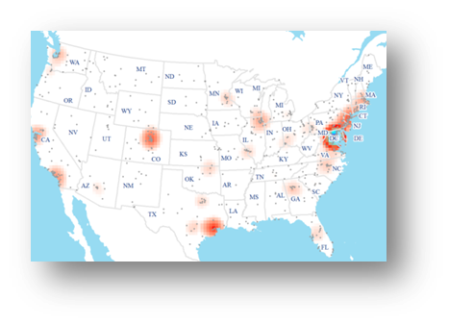
What is the GIS Job Market?
Industry grew by double digits in early 2010‘s
Is considered a “high growth industry“ (Dept. of Labor)
Expected annual growth of 35% each year through 2020
Florida was 4th of top 10 job postings states in GIS
Can earn an annual salary of up to $70,000
GIS Analyst (Information Technology Sector) rank in top 100 of Best Jobs in America (CNN Money)
Diversity of available jobs based on all educational levels

Slide 8
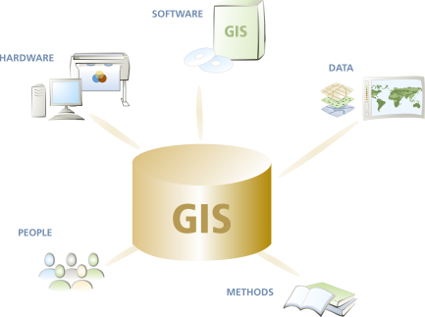
What Are the Parts of a GIS?
Hardware
computers, printers, servers
Software
programs, applications
Data
information, tables,
spreadsheets, databases
Methods
how to ask questions
People

Slide 9
GIS Integrates All the Parts… to See the Whole Picture!
Students
Future Development
Streets & Transportation
School Attendance Zones
Cities, Zoning & Land Use
Aerial Photography
Reality

Slide 10
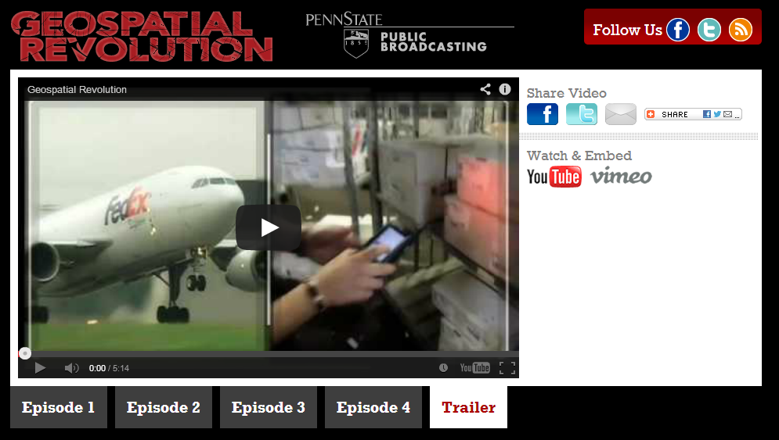
Movie Trailer on Geospatial Technology from Penn State University
(Geospatial Revolution Project)

Slide 11

42 Amazing Maps
That help me understand the world around me and my place in it by John Green

Slide 12

My Information

Slide 13
Materials for Intro into ArcGIS.com

Slide 14
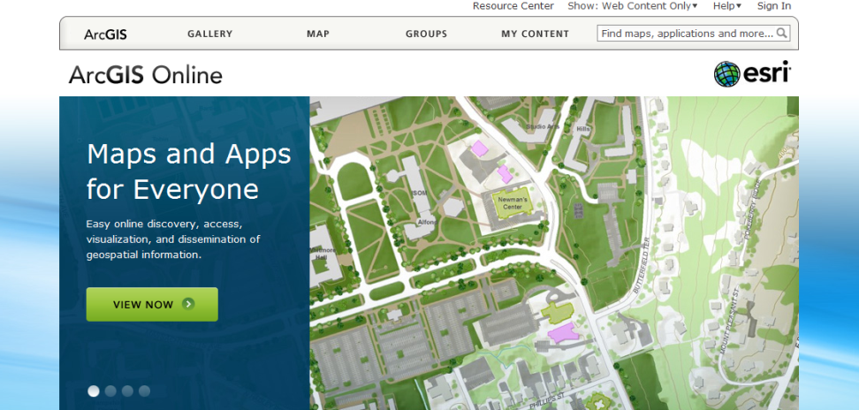
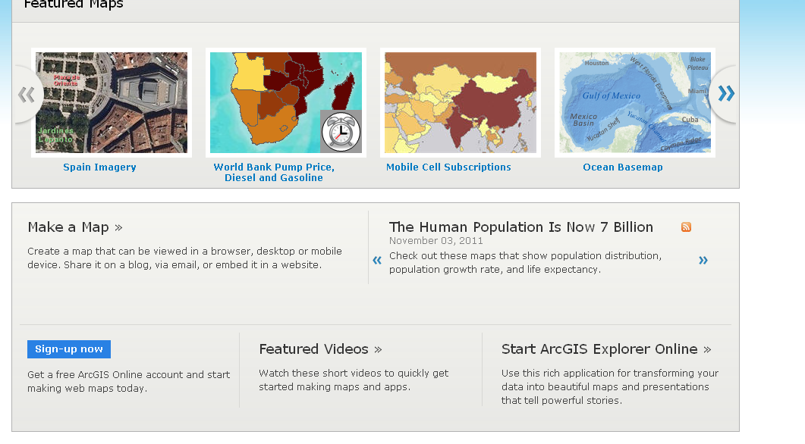
Type in www.arcgis.com on your browser; click Start ArcGIS Explorer Online at the bottom right

Slide 15
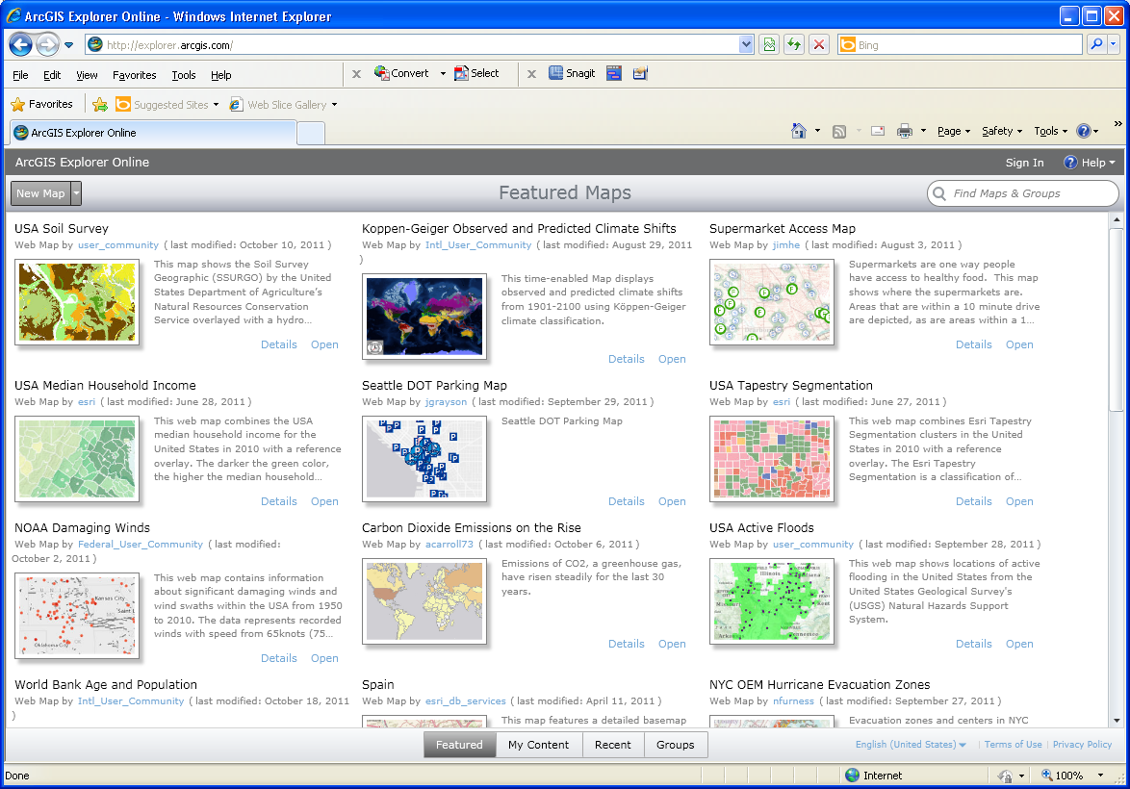
Sign in to your account

Slide 16

Select “New Map” at top left in ArcGIS Explorer Online

Slide 17
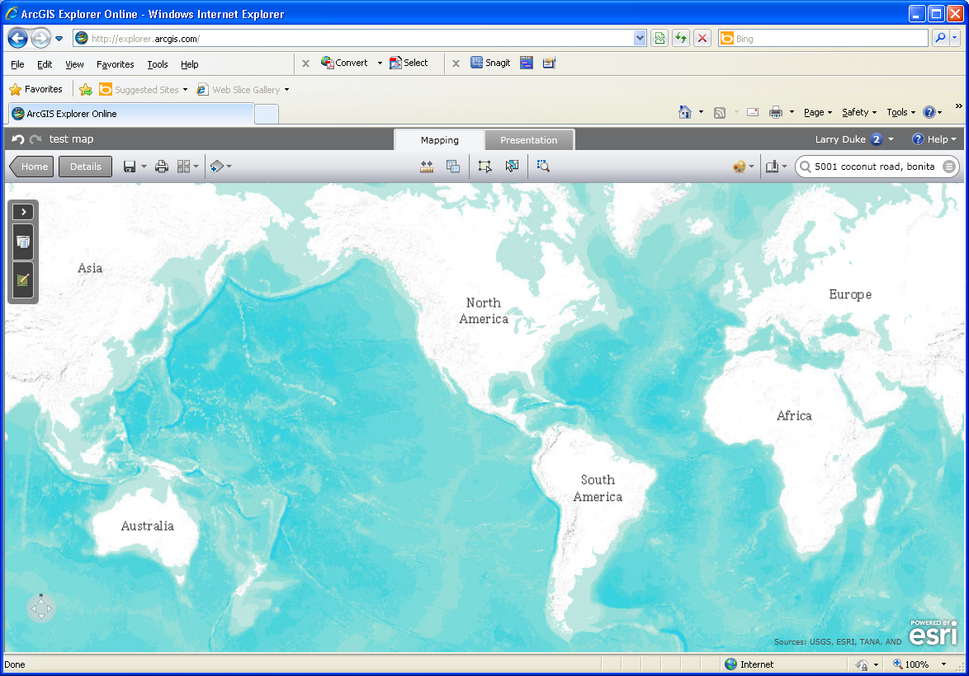

Customize Your Map (continued)
Measure, Query, Draw features,
Create Presentations
You can:
Measure Distance
Measure area
Query
Draw on the Map
Create a Map Presentation
Pan/Zoom Tool, Coordinates

Slide 18
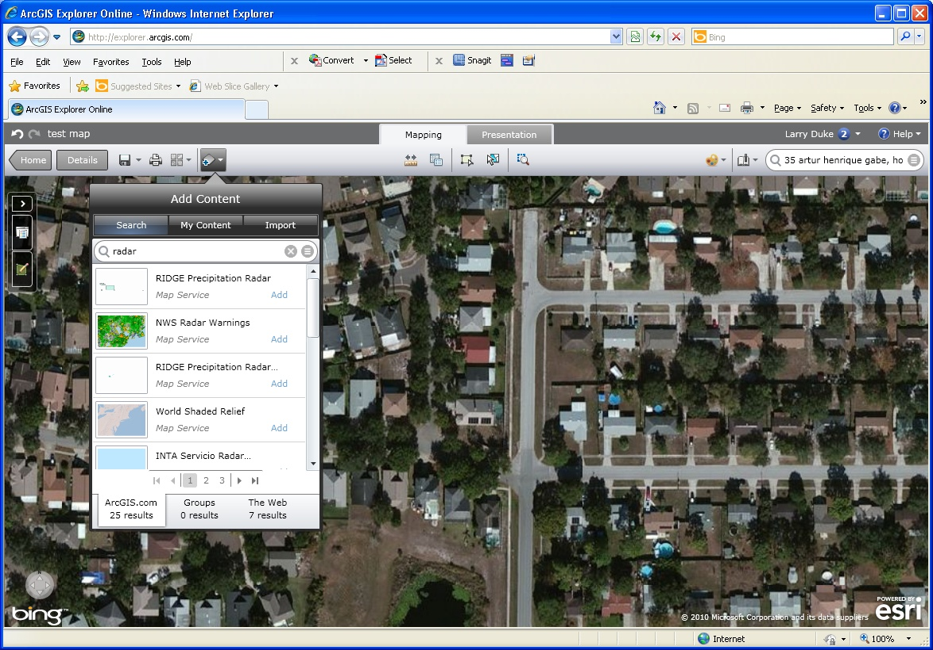
Customize Map (continued)
You can add data from contributors all over the world, or data you create.

Slide 19
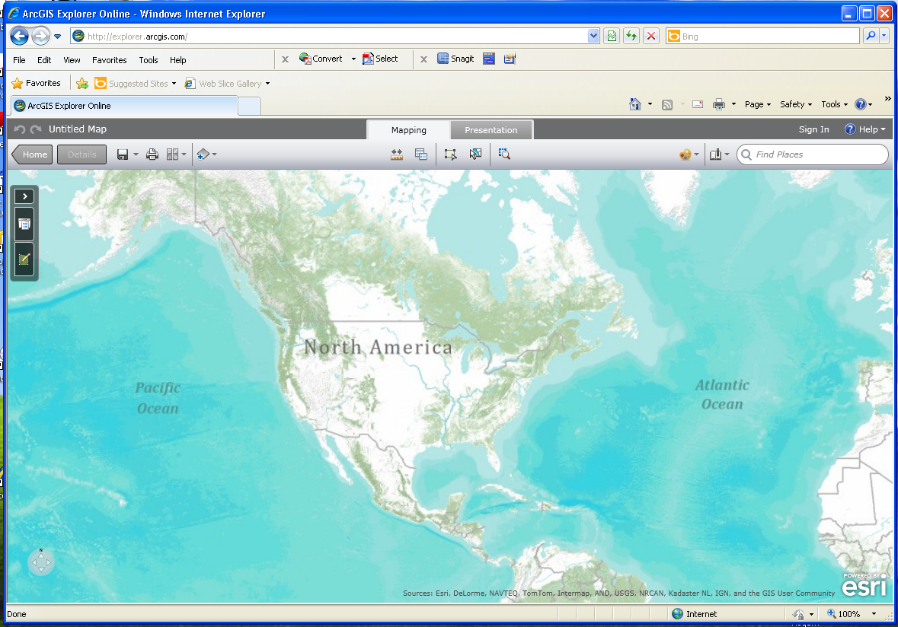
Your first Map
Customize your map:
Change Base-map
Add data
Add Bookmarks
Find Places
Save Your Map
Add Data, Change base-map, Save map
Search for Places, Add bookmarks

Slide 20
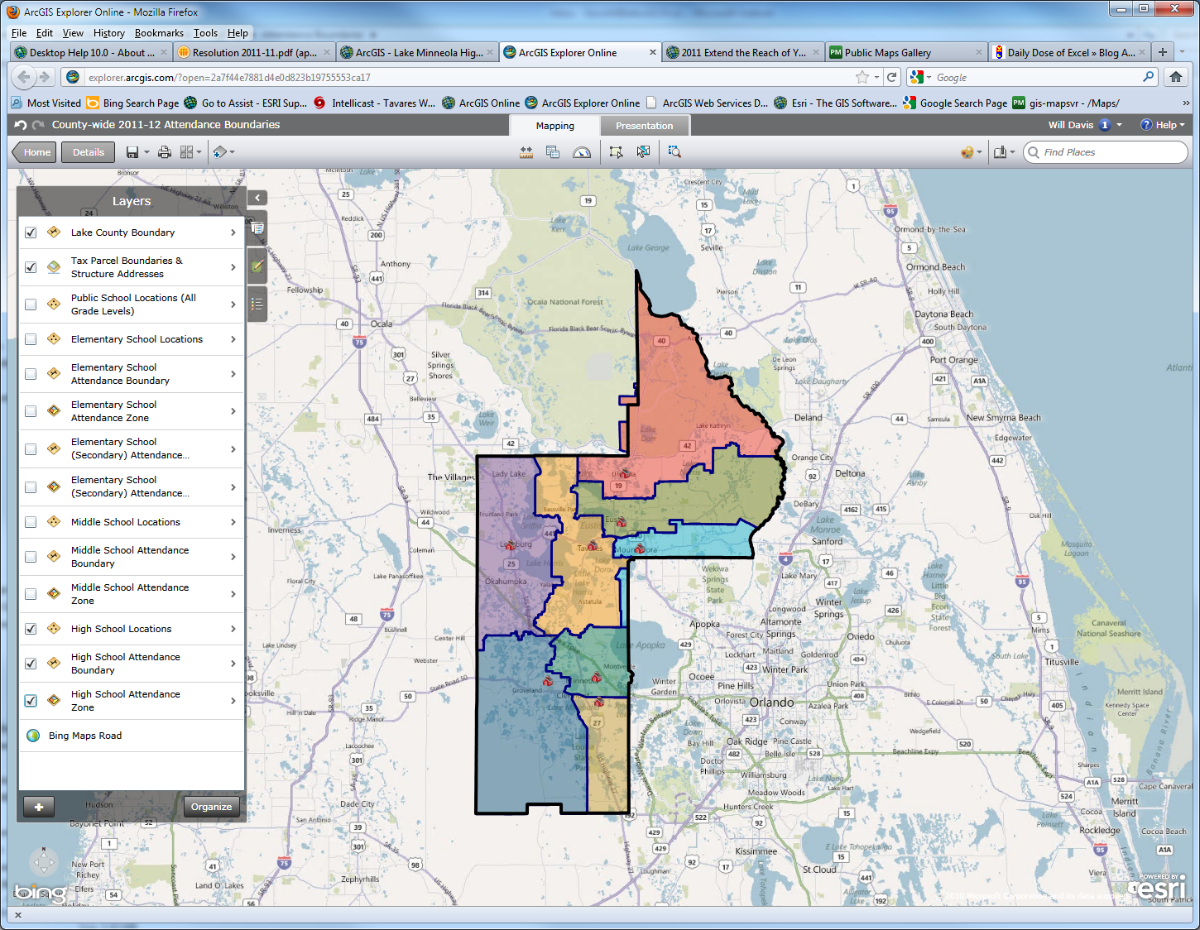
ArcGIS Explorer Online Demo

Slide 21
Web sites of interest
www.lakecountyfl.gov/
www.lake.k12.fl.us/GISDay
GIS Information – www.gis.com
GIS Day – www.gisday.com

